Slide 1
Intro to Medical Science: Cardiovascular System Part 3:
(The Pipes) Arteries and Veins
Slides to accompany Podcast Episode #18. For more Intro to Medical Science visit www.nlorem.org

Slide 2
Find our Podcast Series on any of your podcast streaming apps or on our website, www.nlorem.org Questions/inquiries can be sent to podcast@nlorem.org

Slide 3
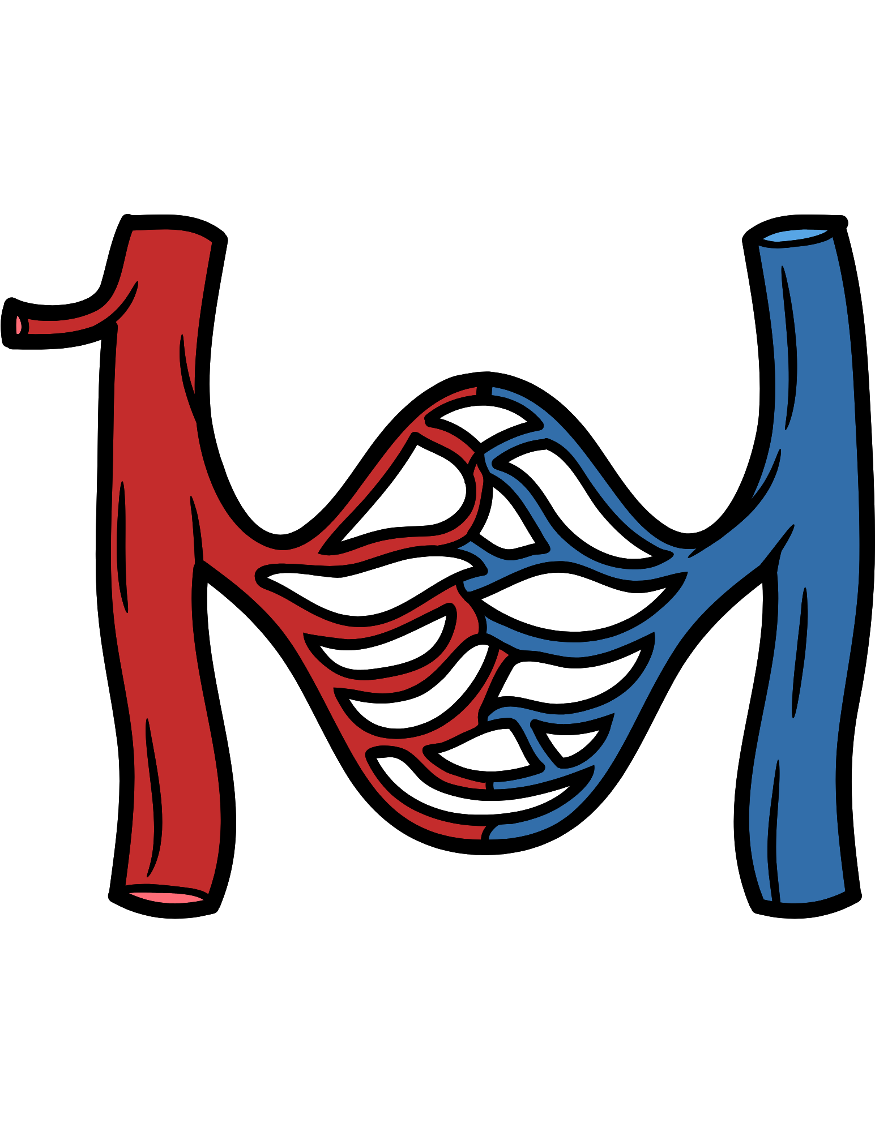
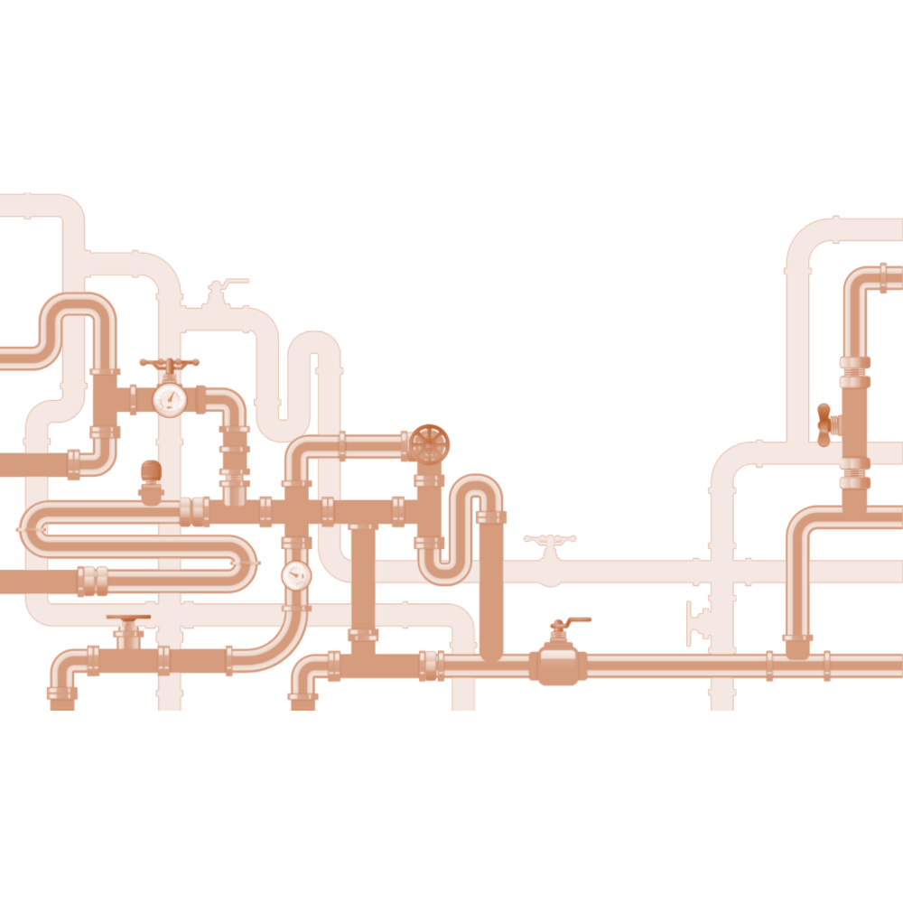
Arteries and Veins
The pipes of the cardiovascular system are responsible for carrying blood through the body
We have two kinds of pipes: an arterial system and a venous system
Notes:
ADD Banner:
The concept of receptors was unproven for 80 years until the cloning of the first receptor

Slide 4
Arteries
Most arteries are responsible for managing blood flow under high pressure
Systolic blood pressure refers to when the left ventricle is contracting
Normal systolic blood pressure is 120-140 millimeters of mercury (mmHg)
Diastolic blood pressure refers to when your left ventricle is filling
Normal diastolic blood pressure is 80-90 mmHg
Key Point: The peripheral arterial system is a high-pressure high flow system
Key Point: To manage blood flow at high pressures and high flow rates, the arteries are very muscular
The arteries can withstand a pressure of up to 300 mmHg
Notes:
ADD Banner:
The concept of receptors was unproven for 80 years until the cloning of the first receptor

Slide 5
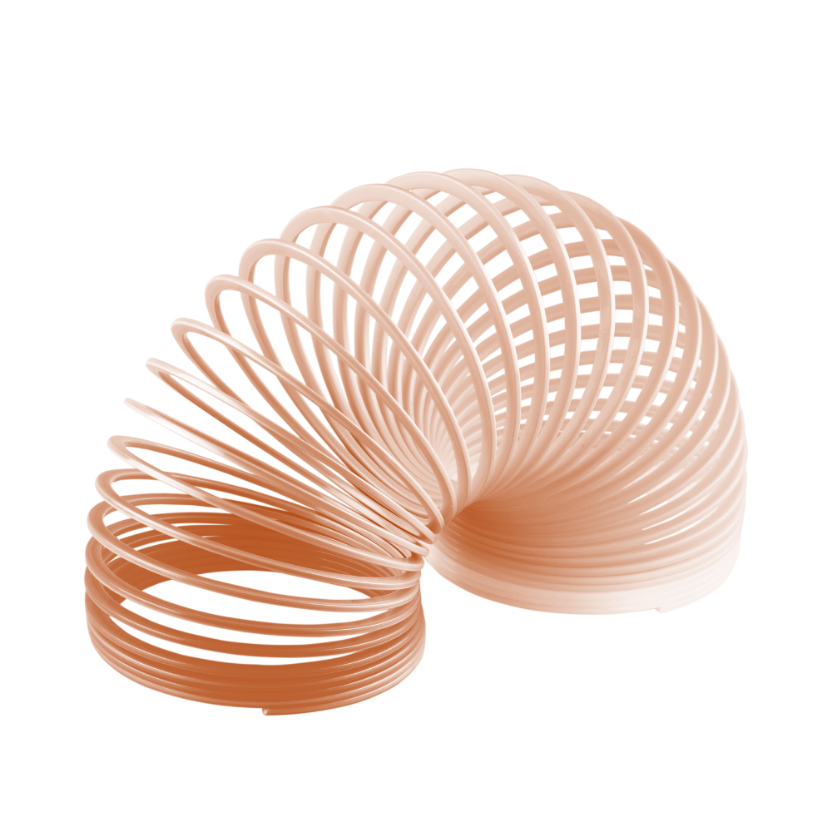
Arterial Structure
Key Point: Arteries must be highly elastic so that they can expand and contract to withstand the daily changes in blood pressure
Arteries are made of muscle fibers
To be elastic, there are spaces made of collagen and other very elastic materials
Key Point: The lining or endothelium of arteries is designed to keep the arterial wall smooth so that blood flows evenly
The endothelium is very thin, usually just a few cells

Slide 6
Arterial Structure (Cont.)
Key Point: The endothelium is an active part of the organ, with new cells being made all the time. Resident cells involved in inflammation and clotting work in concert with cells and clotting factors that flow in the blood
Resident cells in the endothelium also recognize a rip or tear and help initiate the clotting process
Scab formation, which was previously discussed, also happens in arteries
The pipes in your body are much more complicated than the pipes in your house!
Key Point: Chronic inflammation can be caused by many factors, but when it happens, it can lead to atherosclerosis, one of the great killers of modern man

Slide 7
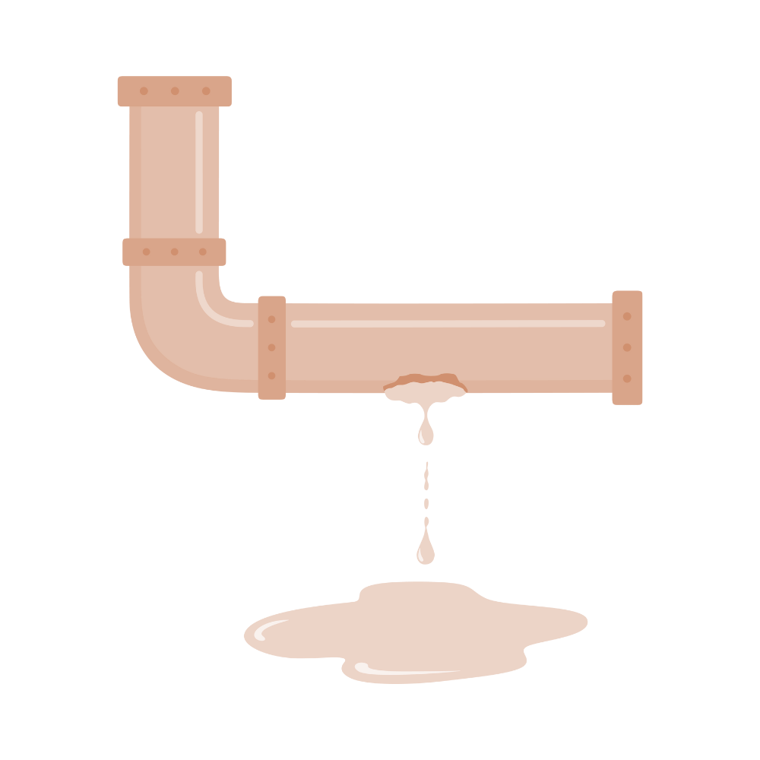
Arterial Structure (Cont.)
After the endothelium, the next group of cells are the smooth muscle cells
These are managed by autonomic nerves
Autonomic meaning you do not have to think about it for it to work
As atherosclerosis progresses, the endothelium is destroyed, the smooth muscle cells are destroyed, and the risk of a tear in a major artery progresses.
This is called an aneurysm, and is most common in the artery that does the most work, the descending aorta

Slide 8
Arterioles
Key Point: Systemic arteries are highly muscular and elastic. They eventually divide into arterioles and capillaries. Veins, because they manage blood at low pressure, have much less muscle than arteries
Tiny and thin arteries are called arterioles
Arterioles are designed to supply oxygen and nutrients to tissues and then collect carbon dioxide
Arterioles can form capillaries to transfer nutrients
Capillaries are fine branches of blood vessels that form a network

Slide 9
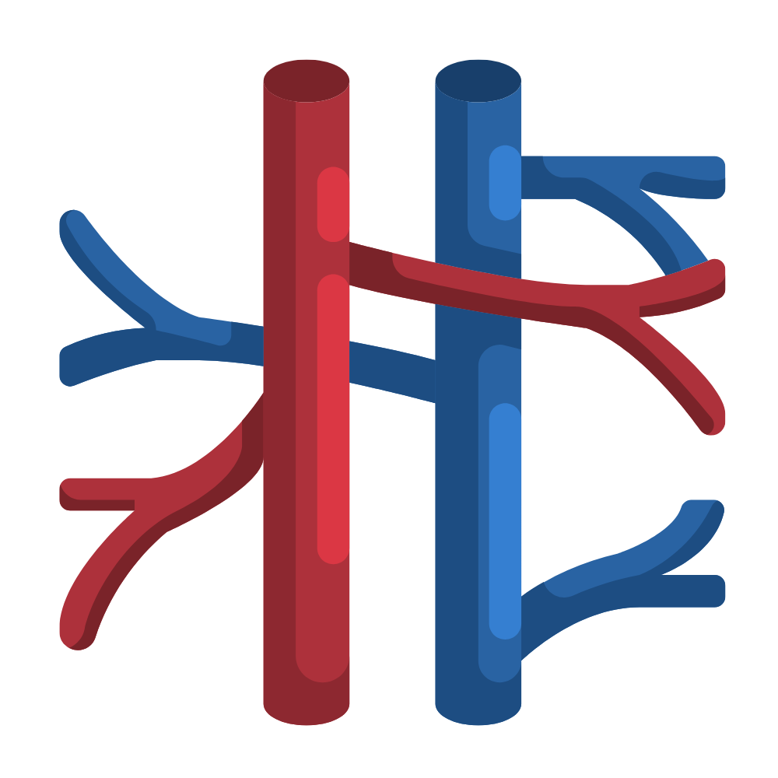
Veins
Veins are designed to move blood at low pressure and slow flow
The goal of veins are to get blood back to the heart
Veins work at pressures of 5-8 mmHg
Blood flows upward through a process called peristalsis
Moves blood with a wave like motion
Because of the low pressure, it is rare that there is a problem with veins ripping
Veins use the same clotting process as arteries
To prevent the formation of clots, blood thinners are used
They have a bad therapeutic index, and can result in nosebleeds and bruising

Slide 10
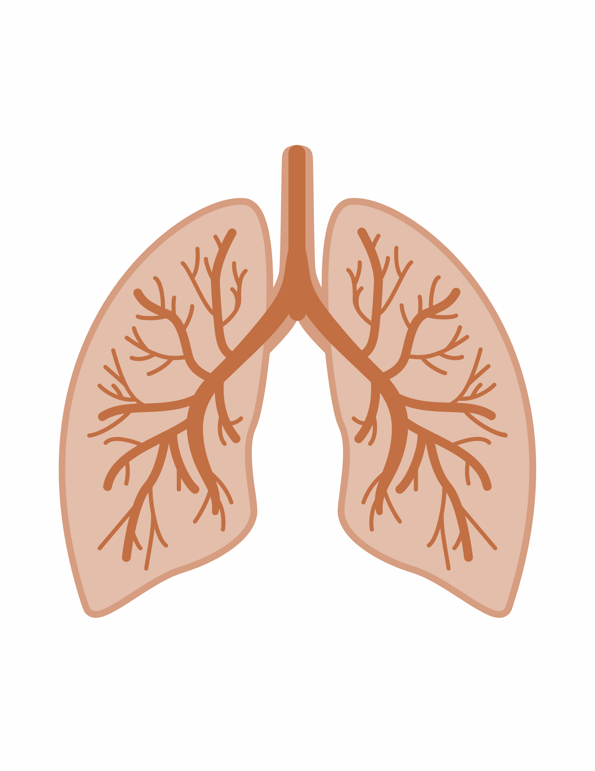
Pulmonary Vascular System
Key Point: The pulmonary vascular system manages blood flow at about the same pressure as the veins
The pulmonary vascular system pumps blood at pressures of 5-15 mmHg
Pulmonary veins collect oxygenated blood from the lung and deliver it to the left heart
A pulmonary embolism is a sudden blockage in your pulmonary arteries, the blood vessels that send blood to your lungs

Slide 11
Follow us on:
Instagram:
nloremfoundation
Facebook:
@nloremfoundation
Linked In:
n-Lorem Foundation
Twitter:
@n_lorem

Slide 12
Thank you for watching!
Find more podcasts and videos at:
www.nlorem.org

