Slide 1
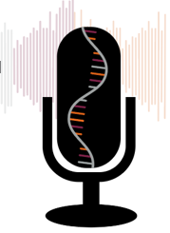
Intro to Medical Science: Cardiovascular System Part 2B:
(The Pump) Heart Diseases
Slides to accompany Podcast Episode #16. For more Intro to Medical Science, visit www.nlorem.org

Slide 2
Find our Podcast Series on any of your podcast streaming apps or on our website, www.nlorem.org Questions/inquiries can be sent to podcast@nlorem.org

Slide 3
Diseases of the Heart (Categories)
Diseases of the heart can be divided into two categories:
Diseases indigenous to the heart
1.
Diseases caused by factors outside of the heart
2.
Key Point: Diseases of the heart can be caused by problems in the heart or by other parts of the cardiovascular system

Slide 4
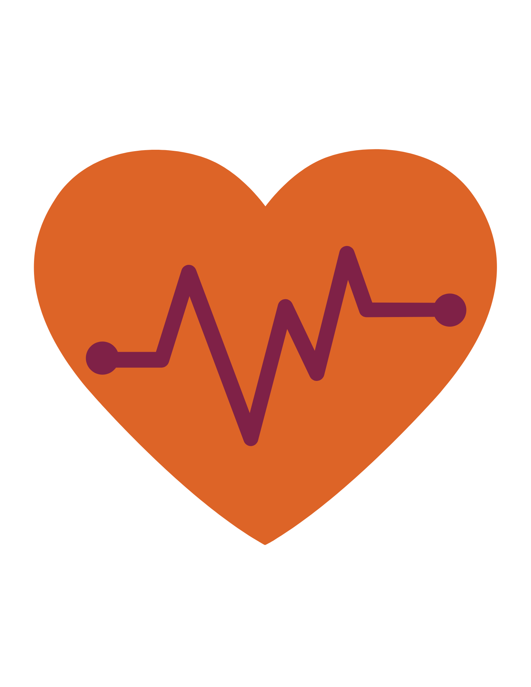
Diseases Caused By Problems Within
Key Point: Diseases of the heart that are indigenous can include problems with the rhythm of the heartbeat, the valve, or problems with creating sufficient force of contraction
Arrhythmia: the heart beats too fast or too slow
A fast heart rate may overwhelm the heart’s electrical systems and result in irregular and inefficient heart beats called atrial flutter
The more extreme version of atrial flutter is called atrial fibrillation
Atrial fibrillation can lead to reduction in cardiac output
Atrial flutter and fibrillation can also result in:
Blood clots may block capillaries in the lung resulting in an embolism, or a sudden blockage in an artery
Ventricular fibrillation is a result of an overwhelmed purkinje system
Key Point: Arrhythmias can be caused by problems with the autonomic nervous system
Notes:
ADD Banner:
The concept of receptors was unproven for 80 years until the cloning of the first receptor

Slide 5
Slow Heartbeats
Bradycardia is a heart rate that's too slow
What's considered too slow can depend on your age and physical condition
Athletes typically have slow heartbeats
Slow heartbeats are not terribly problematic initially, but can result in problems if left untreated
AV block is when the atrium beats more frequently than the ventricle. This happens when the AV node is not transmitting an electrical signal every time it is stimulated
Paroxysmal Ventricular Contractions occur when the ventricle beats on its own
Paroxysmal = every now and then
Frequent paroxysmal ventricular contractions can disrupt normal electrical activity and can lead to ventricular fibrillation

Slide 6
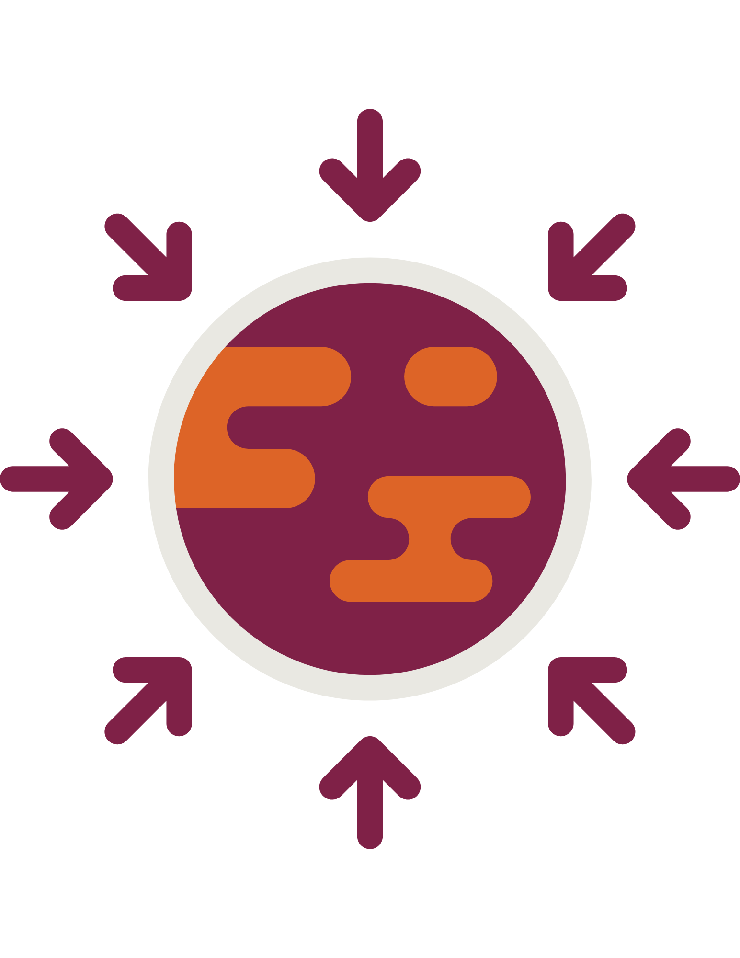
Force Problems
Between the atrium and ventricle, the heart has valves
If these are broken and not fixed, it can result in heart failure
Problems of the heart almost always manifest in the left ventricle, because it does most of the work
Generating force in heart and skeletal muscles involves cycles of depolarization and repolarization
Adenosine triphosphate (ATP) provides the energy to create such a force
Congestive heart failure (also called heart failure) is a serious condition in which the heart doesn't pump blood as efficiently as it should

Slide 7
Causes of Heart Problems
Key Point: Congenital diseases of the heart are common. Many are related to developmental issues, but some are genetically caused. We are only beginning to understand these
It is always important to understand the primary cause of disease
There may be failures or mutations in ion channels that disrupt the rhythm of the heart
Congenital diseases are diseases that are present at birth
Mutations may be passed from parent to offspring
Spontaneous mutations that occur in individuals are called de novo mutations and are not passed from parent to offspring

Slide 8
Problems Outside the Heart
Key Point: Accumulation of fluid may happen in the pericardial space. This can occur from inflammation or bleeding. The ability of the heart to contract may be compromised as a result
The heart’s lining is called the pericardium
Peri = around
Cardium = heart
Pericarditis: Issues with the lining of the heart
Itis = inflammation
A pericardial sac occurs when water builds up between the lining
Hypertension: high blood pressure – common cause of heart failure
Most commonly caused by atherosclerosis, or stiff arteries due to buildup of fats
Also caused by an increase in blood volume which happens if one resorbs too much water and salts

Slide 9
Problems Outside the Heart (Cont.)
A stroke occurs when a blood vessel in the brain bursts due to high blood pressure
An aneurysm occurs when an artery bursts
Heart attacks occur when any artery in the heart is blocked
A block of the LAD, since it supplies the hardest working part of the heart, the left anterior, can often be fatal

Slide 10
Problems Outside the Heart (Cont.)
The end stage of cardiovascular disease is congestive heart failure
Often leads to pooling of blood and plasma in organs
Blood pooling occurs when the blood is unable to pump back up to your heart, and pools (or collects) in your legs, ankles, and/or feet.
Cardiac congestion is the accumulation of fluid in the lungs causes difficulty breathing
Cardiac arrest is the sudden stoppage of the heart
Often preceded by ventricular fibrillation
Demands resuscitation
Adrenaline and dopamine, oxygen, and defibrillation are used to

Slide 11
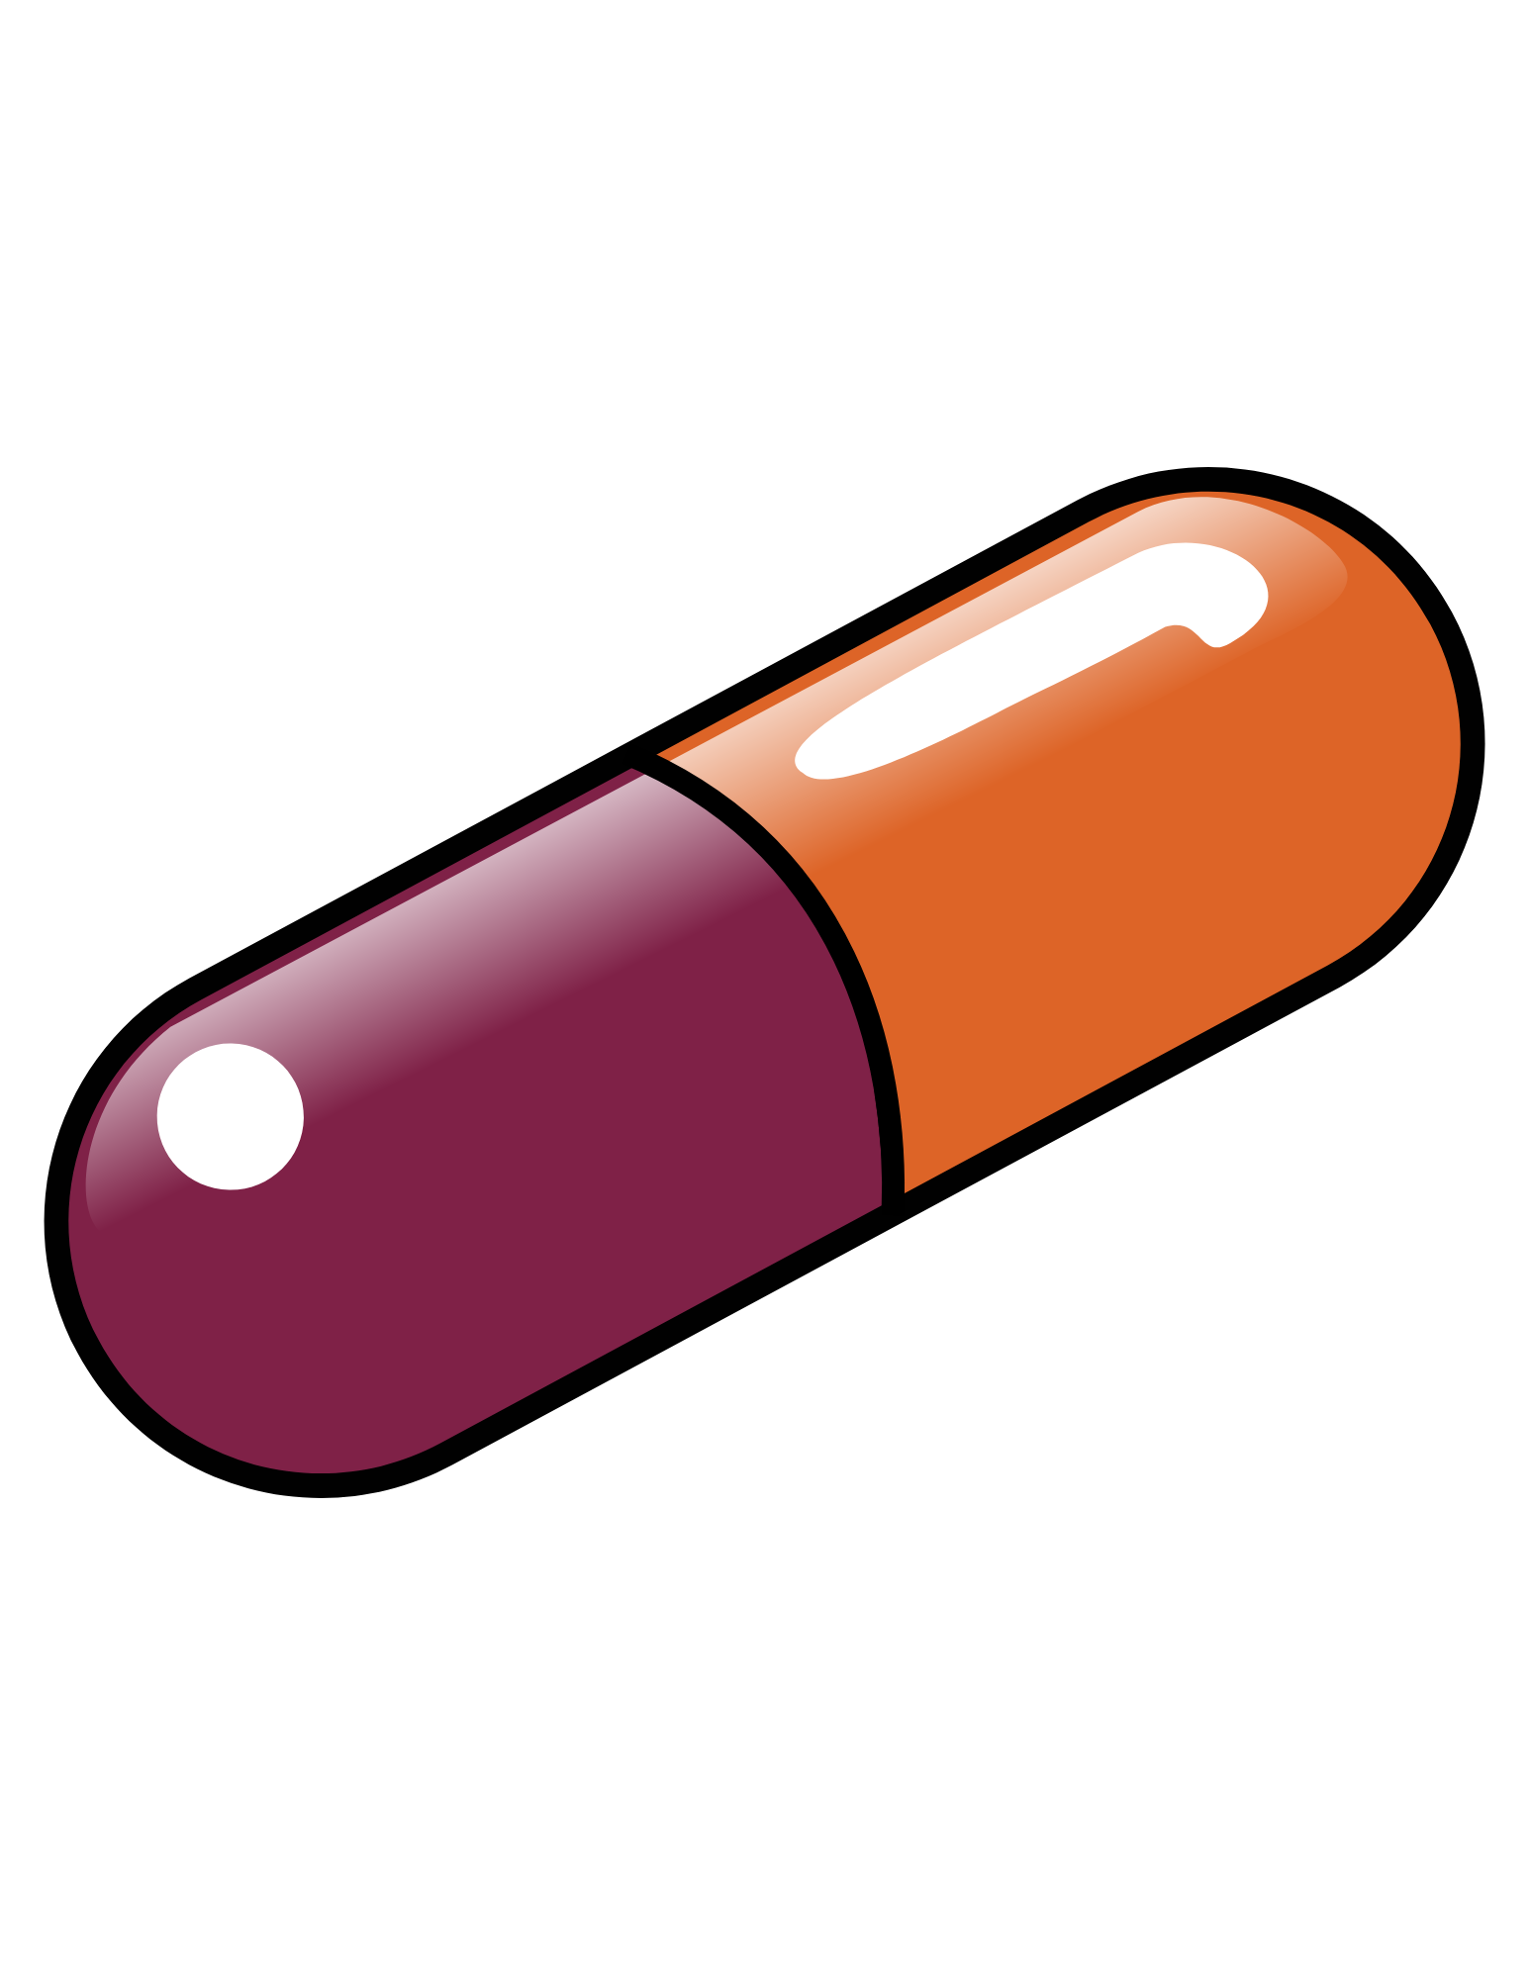
Drugs for Heart Disease
Key Point: There are many types of drugs available to treat various problems caused by any disorder throughout the cardiovascular system
Beta blockers are used to block adrenergic receptors when the heart is beating too fast
Nitroglycerin dilates cardiac arteries and is useful when the heart has stopped
Positive inotropic agents such as digitalis are used in patients with congestive heart failure as they increase the force the ventricles can generate
As the heart begins to fail, more aggressive efforts are used
Higher doses and multiple drugs (12-15 drugs used simultaneously is common)

Slide 12
Follow us on:
Instagram:
nloremfoundation
Facebook:
@nloremfoundation
Linked In:
n-Lorem Foundation
Twitter:
@n_lorem

Slide 13
Thank you for listening!
Find more podcasts and videos at:
www.nlorem.org

