Slide 1
Intro to Medical Science: Cardiovascular System Part 2A: (The Pump) Heart Anatomy
Slides to accompany Podcast Episode #15. For more Intro to Medical Science, visit www.nlorem.org

Slide 2
Find our Podcast Series on any of your podcast streaming apps or on our website, www.nlorem.org Questions/inquiries can be sent to podcast@nlorem.org

Slide 3
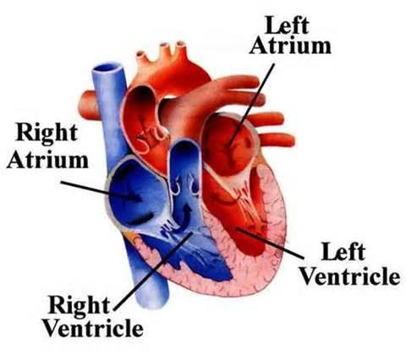
The Heart
The pump of the cardiovascular system is the heart
The heart has four chambers:
Right atrium, right ventricle, left atrium, left ventricle

Slide 4
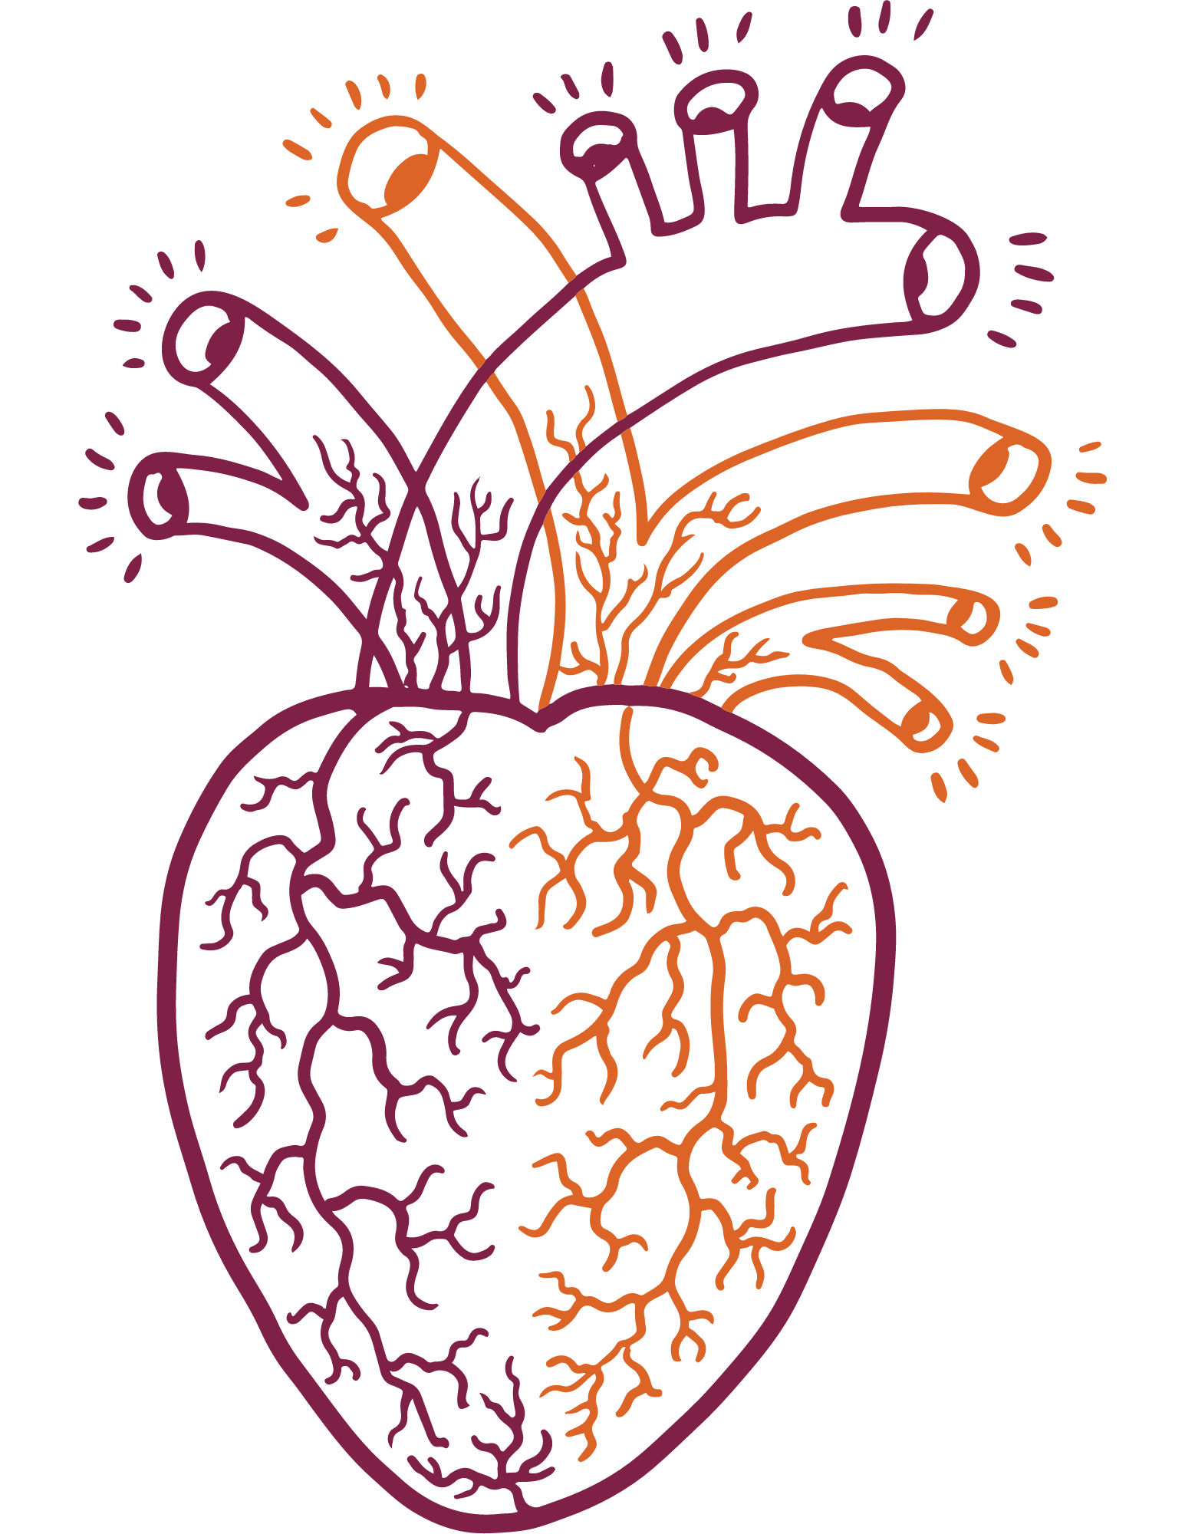
Why is the Heart Two Sided?
Key Point: The heart is two sided because there are two circulatory systems:
Pulmonary circulatory system
Peripheral circulatory system
The pulmonary circulatory system delivers blood to and from your lungs
Low pressure system, managed by right side of heart
The peripheral circulatory system supplies blood to all the peripheral tissue
High pressure system, managed by left side of heart
Notes:
ADD Banner:
The concept of receptors was unproven for 80 years until the cloning of the first receptor

Slide 5
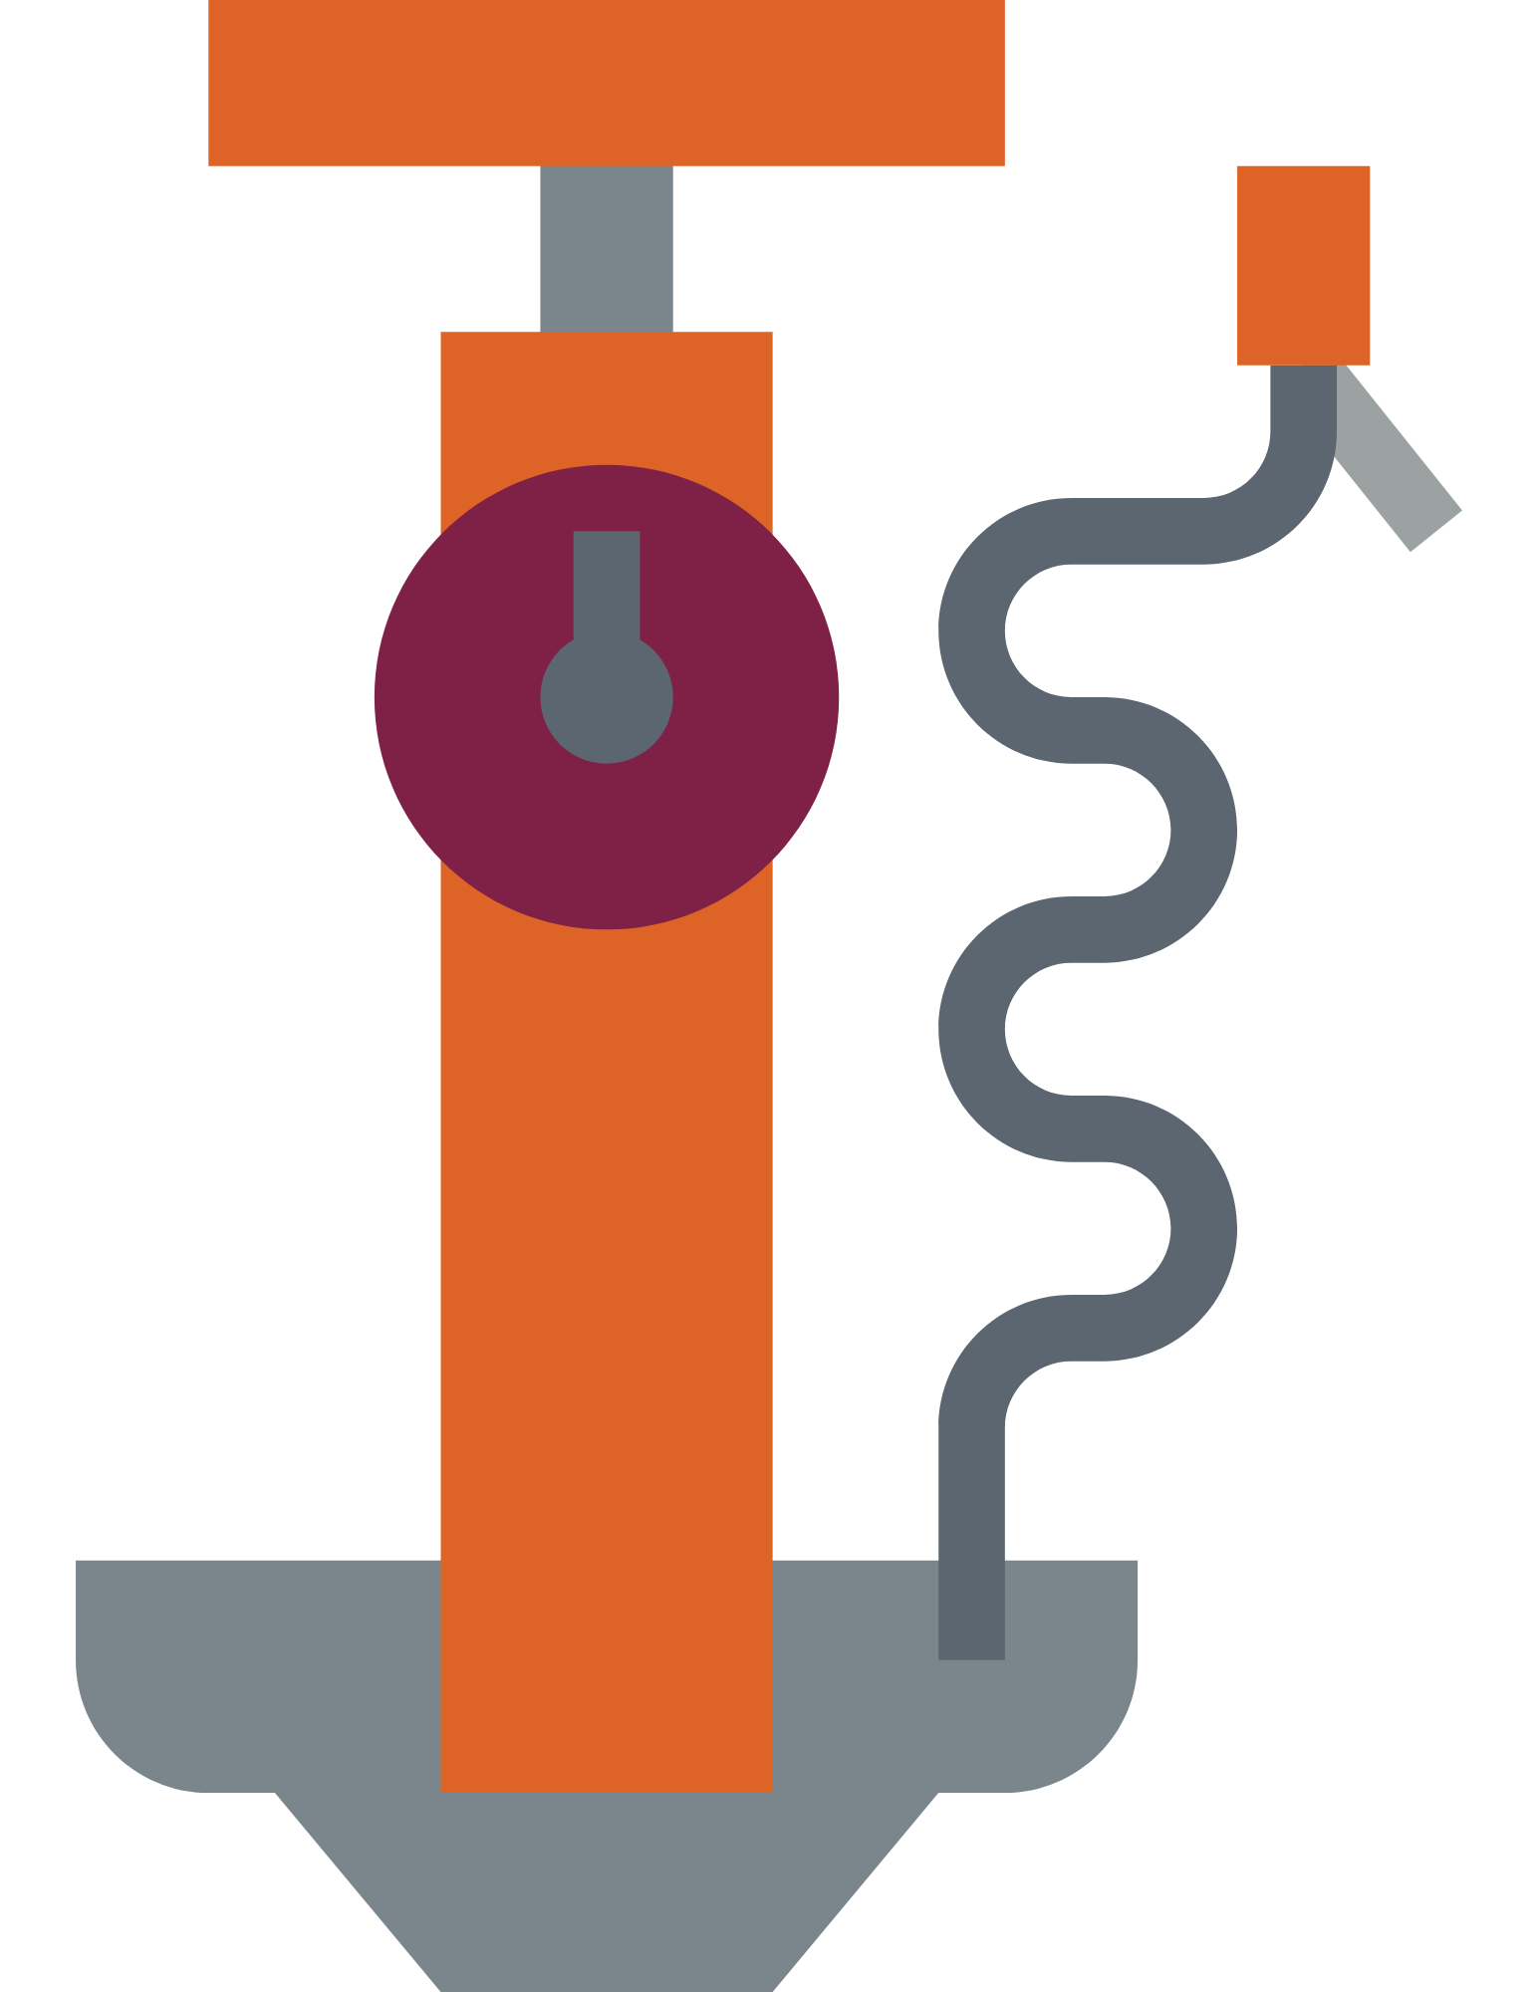
Why Atria and Ventricles?
Key Point: The atria are responsible for ensuring the ventricles are filled with blood before every beat. The ventricles are the true pump
Key Point: The right ventricle pumps blood against 2-8 mmHg, while the left ventricle pumps blood against 120-140 mmHg.
The left ventricle does the most work, therefore, most heart attacks happen in the left ventricle

Slide 6
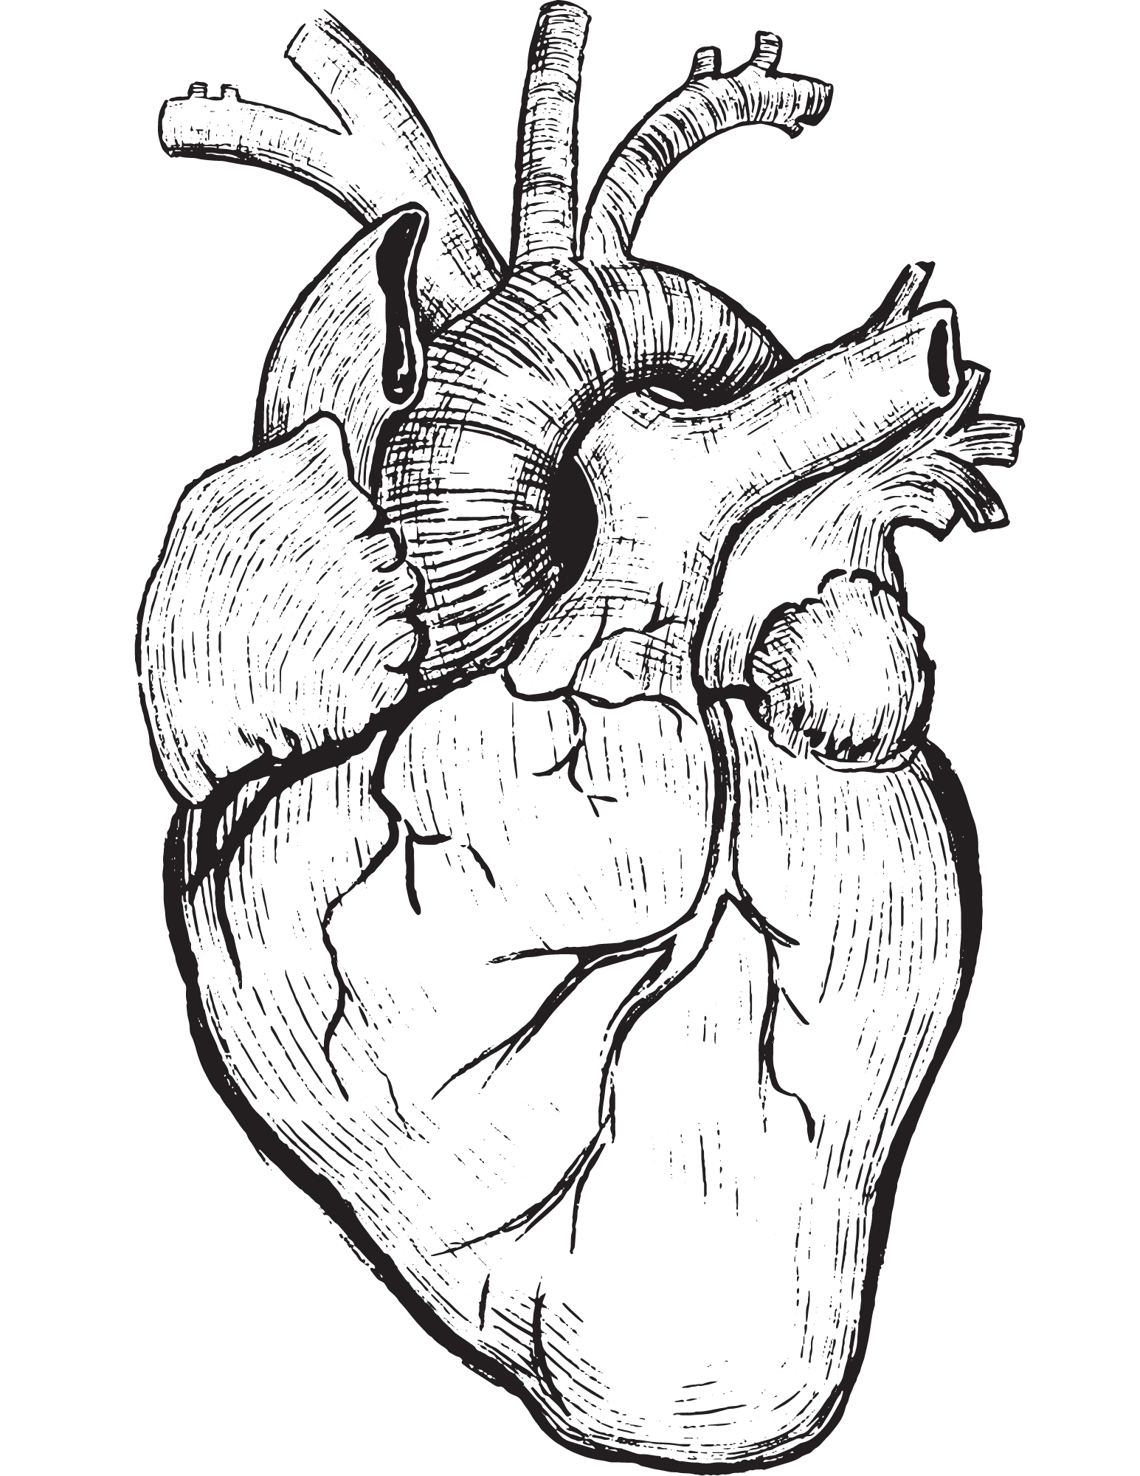
The Cycle – Starting with the Right Side of the Heart
Blood has been sent throughout the body and is now depleted of nutrients
This blood is collected by the venous system and enters the inferior vena cava
The inferior vena cava is the largest vein in your body

Slide 7
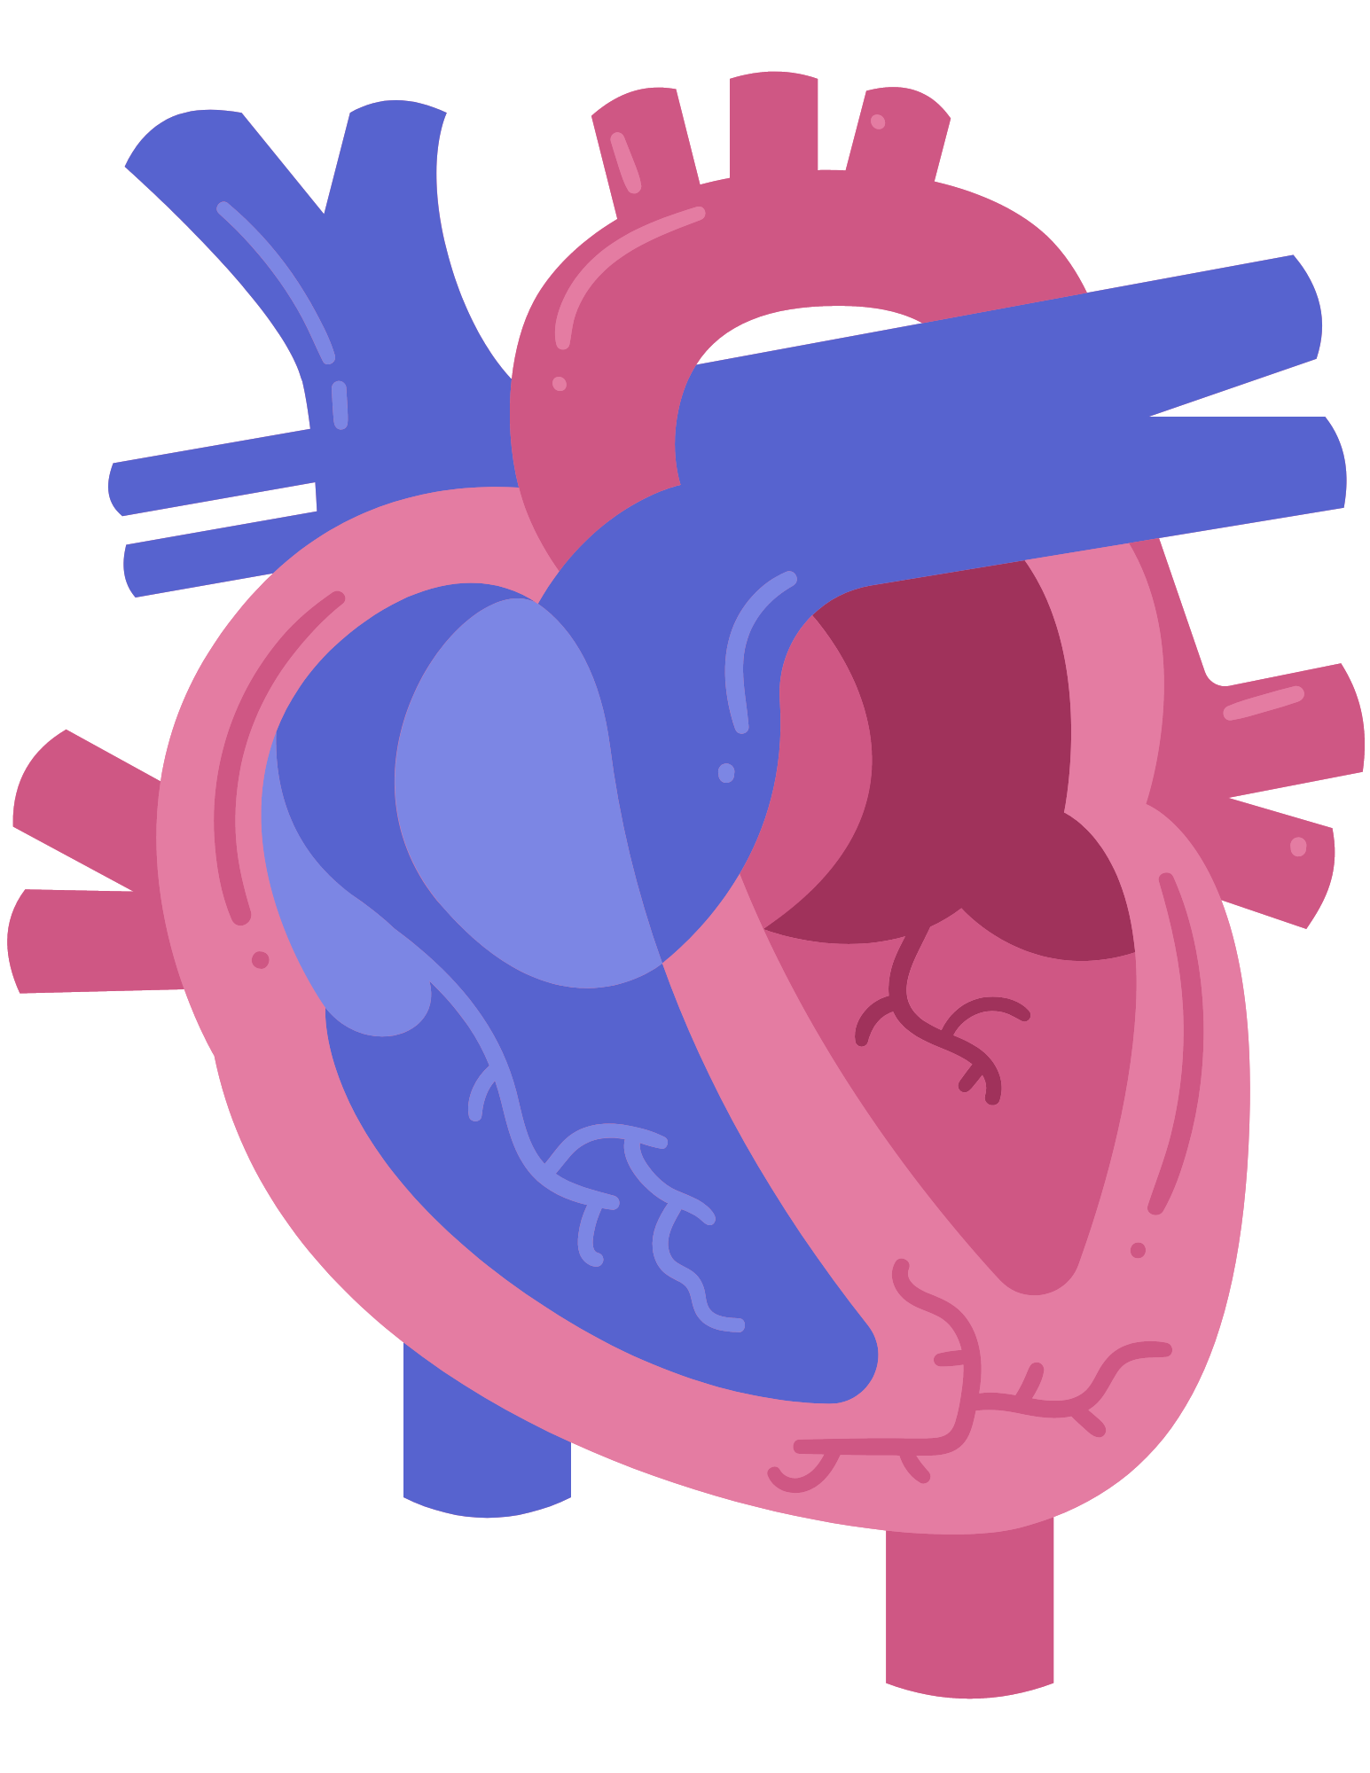
The Cycle - Pulmonary System
Then, the blood is delivered to the right atrium from below - hence why it is called the inferior vena cava
The right atrium fills the right ventricle with every beat
From the ventricle, the blood is pumped to arteries

Slide 8
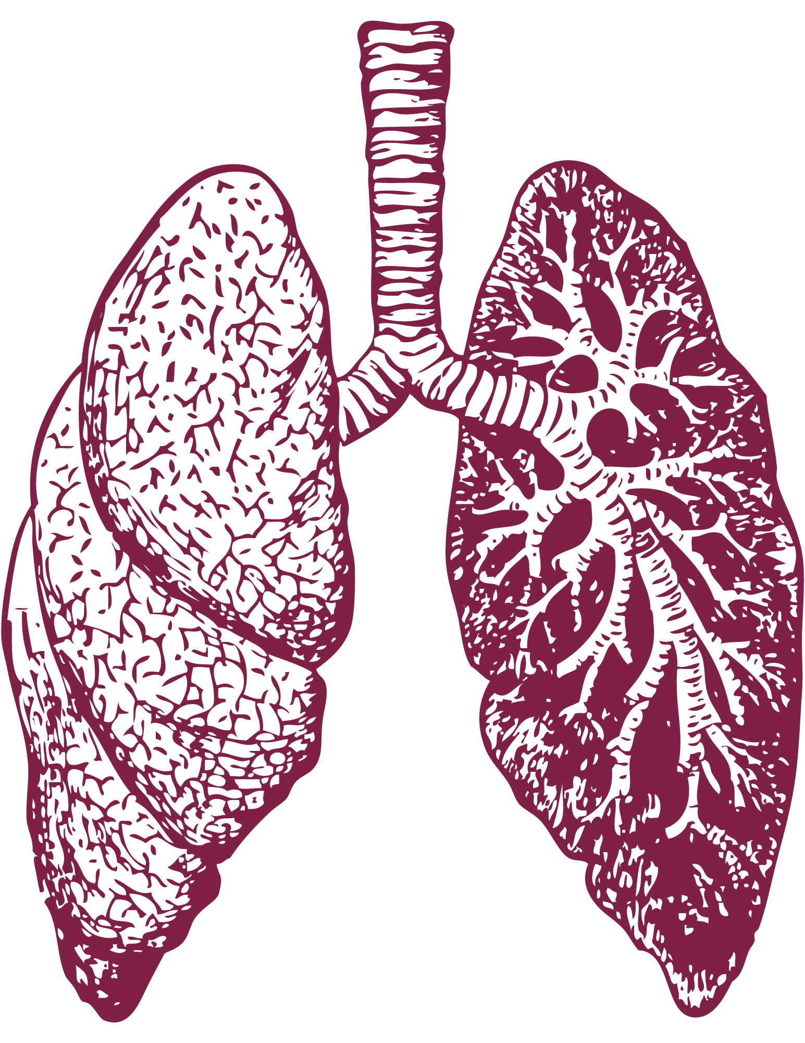
Some Common Questions
To which arteries does blood from the right ventricle get delivered?
The lungs
Recall – The right side of the heart is part of the pulmonary circulatory system
Pulmonary means “relating to lungs”
Why a low-pressure system?
In the lungs, blood needs time to collect oxygen and dispose of carbon dioxide
A low-pressure system guarantees the blood will flow slowly, thus giving is time for these interactions to take place

Slide 9
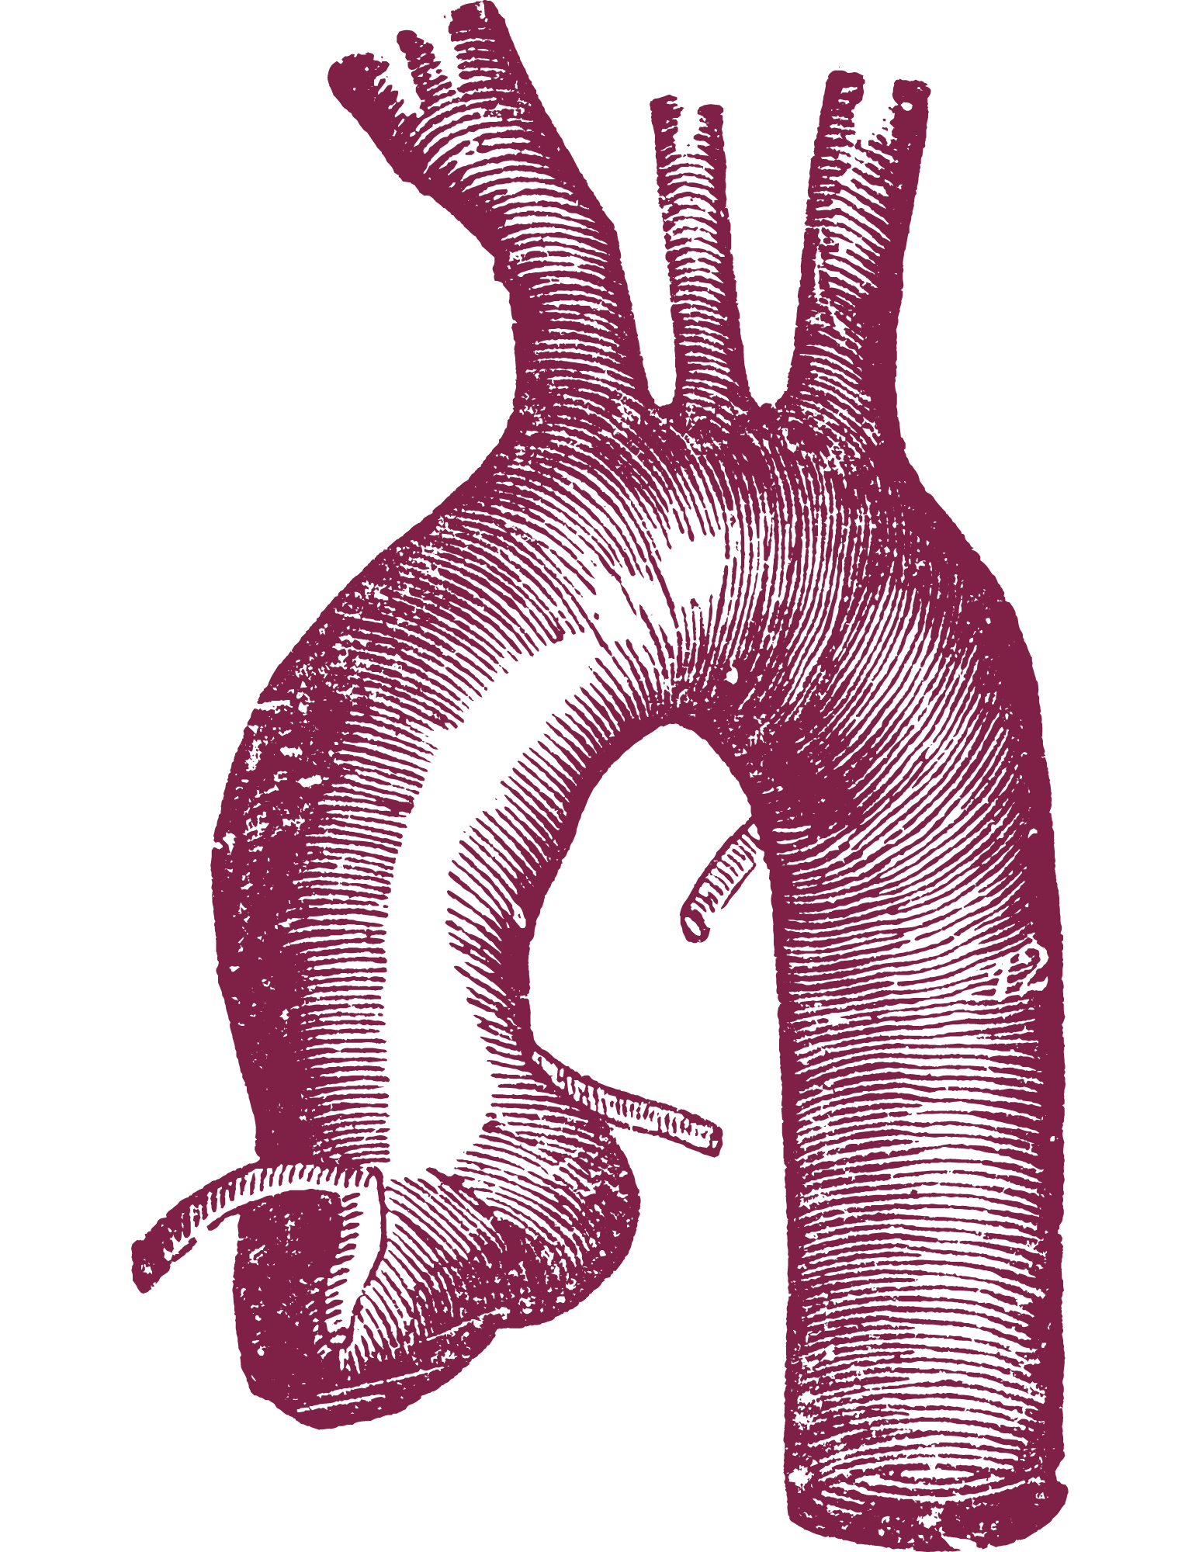
The Cycle - Peripheral System
First, the pulmonary vein delivers oxygenated blood to the left atrium
The left ventricle pumps blood to the aorta
Aorta: The largest and most powerful blood vessel
The ascending aorta supplies oxygen to the veins via the carotid arteries
The descending aorta supplies oxygen to all the other peripheral tissues (except the lungs – that’s the pulmonary system)

Slide 10
Doesn’t the Heart Need Its Own Supply of Blood?
Yes!
The left anterior descending artery (LAD) supplies blood to the left ventricle
Any blockage to the LAD can result in a fatal heart attack
The LAD is often called the widowmaker – any blockage of this artery has a high risk of death

Slide 11
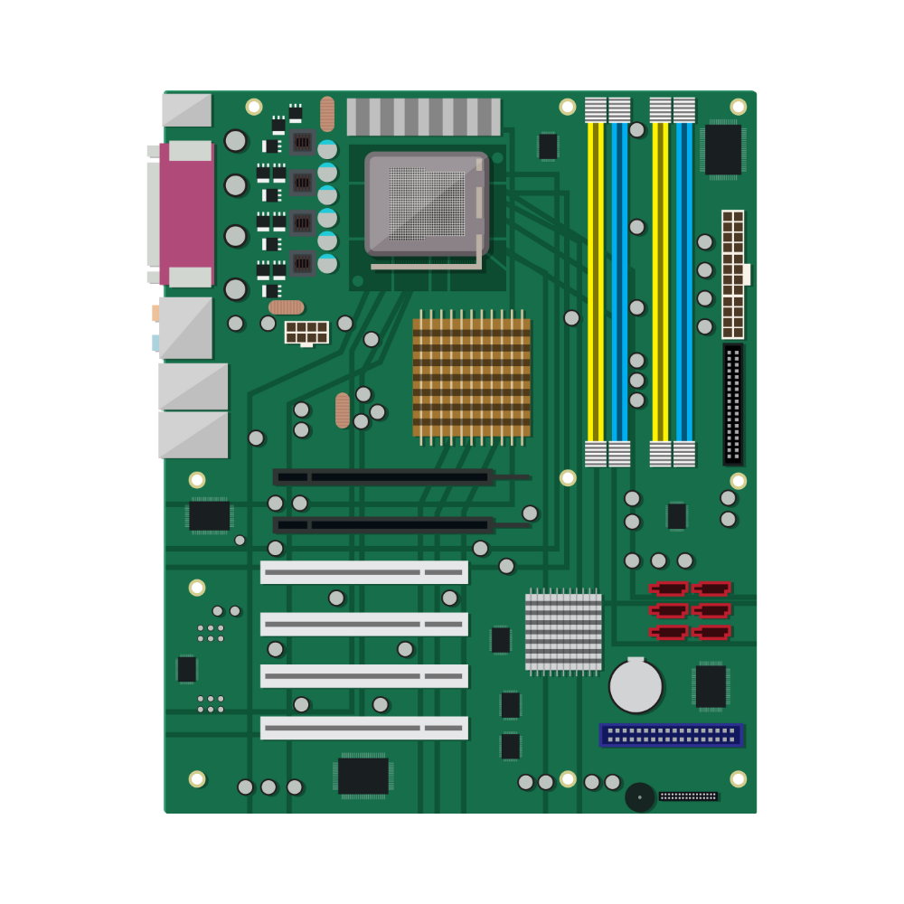
Electrical Circuits – How the Heart Beats
Key Point: The purkinje system consists of the electrical system of the heart. It controls how fast the heart beats
A current is delivered regularly throughout the heart to stimulate contraction and relaxation
This is what causes the heart to beat rhythmically
Certain cells, such as neurons, have mechanisms to make the plasma membrane electrically unstable
The cell membrane is a semipermeable (allowing only certain substances to pass through) membrane surrounding the cytoplasm of the cell
An electrical current is generated by moving charged ions across the cell membrane
The process of changing a cell from its normal, negatively charged state to a neutral state is called depolarization/repolarization

Slide 12
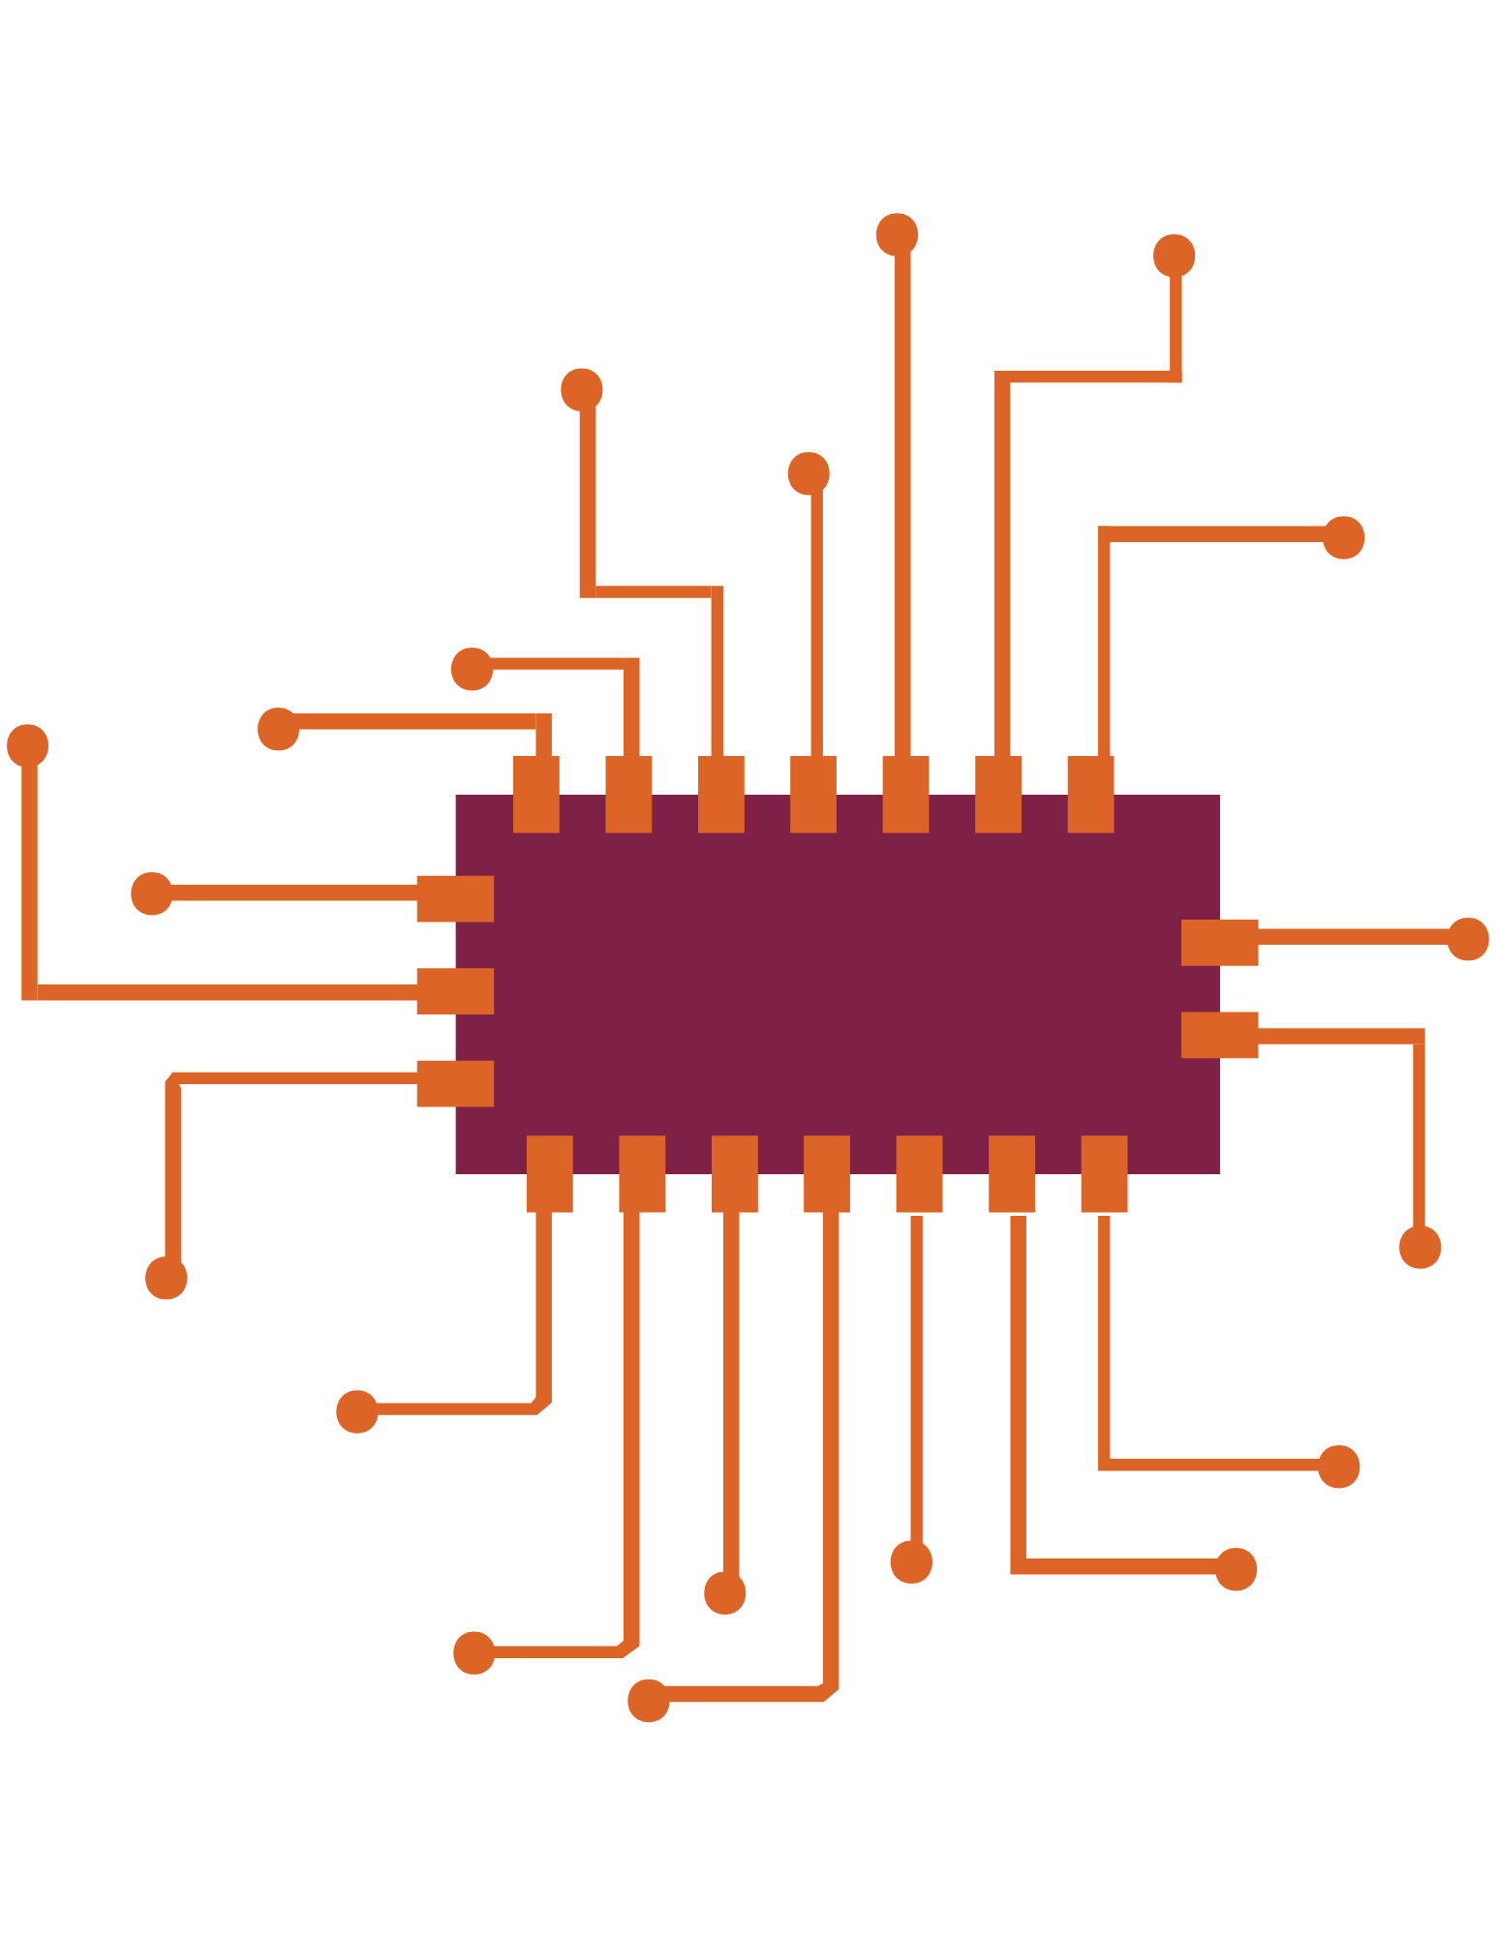
Sinoatrial (SA) Node
Key Point: The SA node is the metronome of the heart. Left to its own devices, it would cause the heart to beat faster were it not controlled by the cholinergic nerve fibers in the autonomic nervous system
SA Node: An area of cells in the atrium that undergo rapid depolarization and repolarization cycles
The autonomic nervous system is a component of the peripheral nervous system that regulates many involuntary (hence “auto”) processes

Slide 13
How We Adjust Our Heart Rate
The autonomic nervous system can speed up and slow down heart rate
Adrenergic system: produces adrenaline and noradrenaline and can make the plasma membrane more unstable, which results in an increase in heart rate
Cholinergic system: produces acetylcholine that reduces the rate on depolarization and repolarization, slowing the heart down
The autonomic nervous system controls blood pressure
The adrenergic system can increase blood pressure by causing arteries to contract
The cholinergic system can decrease blood pressure by causing arteries to dilate

Slide 14
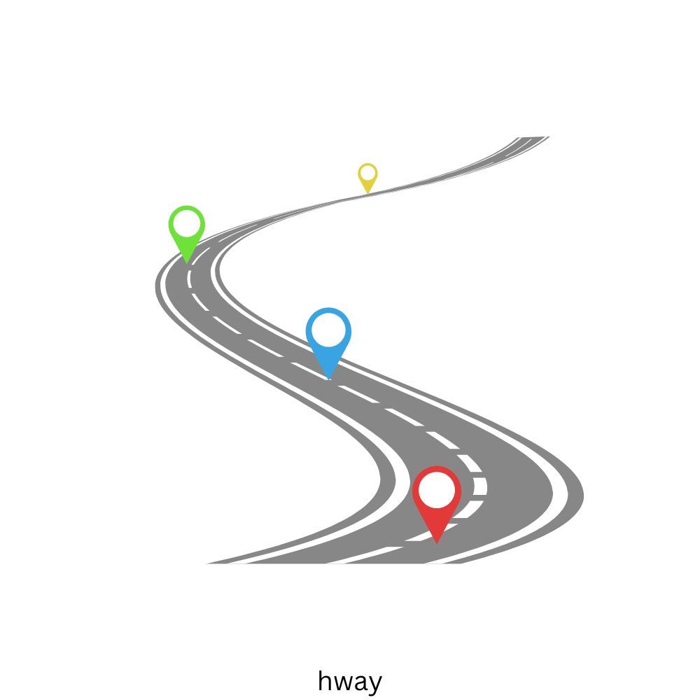
Pumping Blood - The Pathway
The right atrium fills the right ventricle
The right ventricle pumps blood into the lungs through the pulmonary artery
The pulmonary artery divides into small capillaries that are distributed evenly into alveoli
Alveoli are tiny sacs of air surrounded by a thin membrane, or lining
The alveoli must collect oxygen from the air and dispose of carbon dioxide
The blood then goes to the left atrium and, through the left ventricle, is pumped into the systemic circulatory system

Slide 15
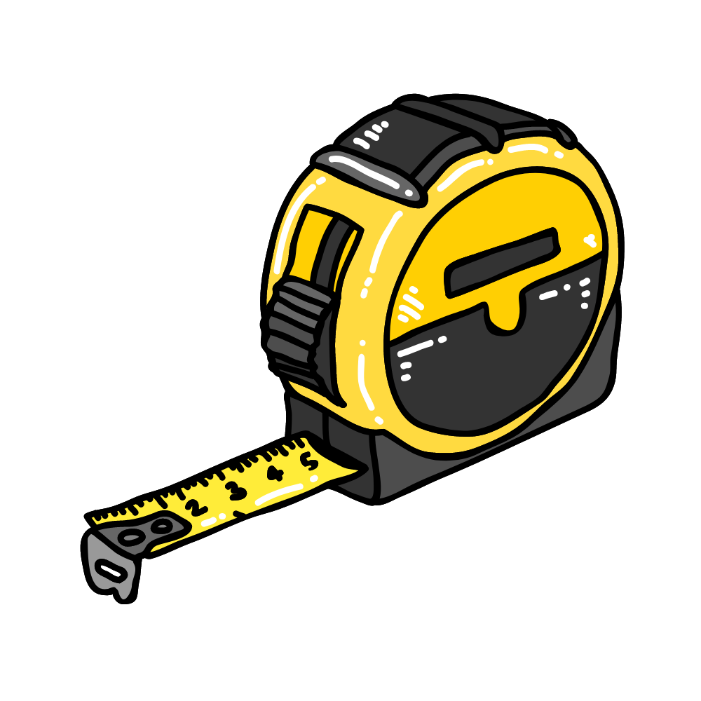
Measuring The Pump
Key Point: Cardiac output is the best measure of how the heart is doing in meeting its primary function of delivering systemic blood to all tissues
The chronotropic functions of the heart are to beat steadily and rhythmically
Chrono = time
Tropic = function
The inotropic functions are to create the force necessary to pump blood throughout the body
Ino = force

Slide 16
Follow us on:
Instagram:
nloremfoundation
Facebook:
@nloremfoundation
Linked In:
n-Lorem Foundation
Twitter:
@n_lorem

Slide 17
Thank you for watching!
Find more podcasts and videos at:
www.nlorem.org

