Slide 1
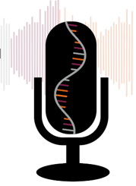
Intro to Medical Science: Cardiovascular System Part 1: Blood
Slides to accompany Podcast Episode #13.
For more Intro to Medical Science, visit www.nlorem.org

Slide 2
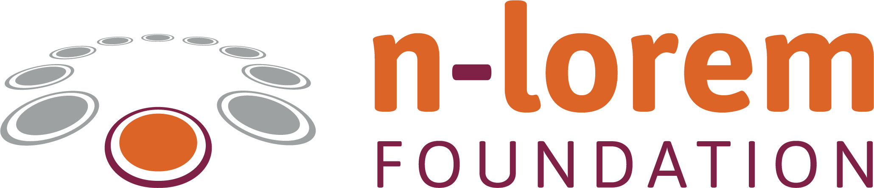

Find our Podcast Series on any of your podcast streaming apps or on our website, www.nlorem.org
Questions/inquiries can be sent to podcast@nlorem.org

Slide 3
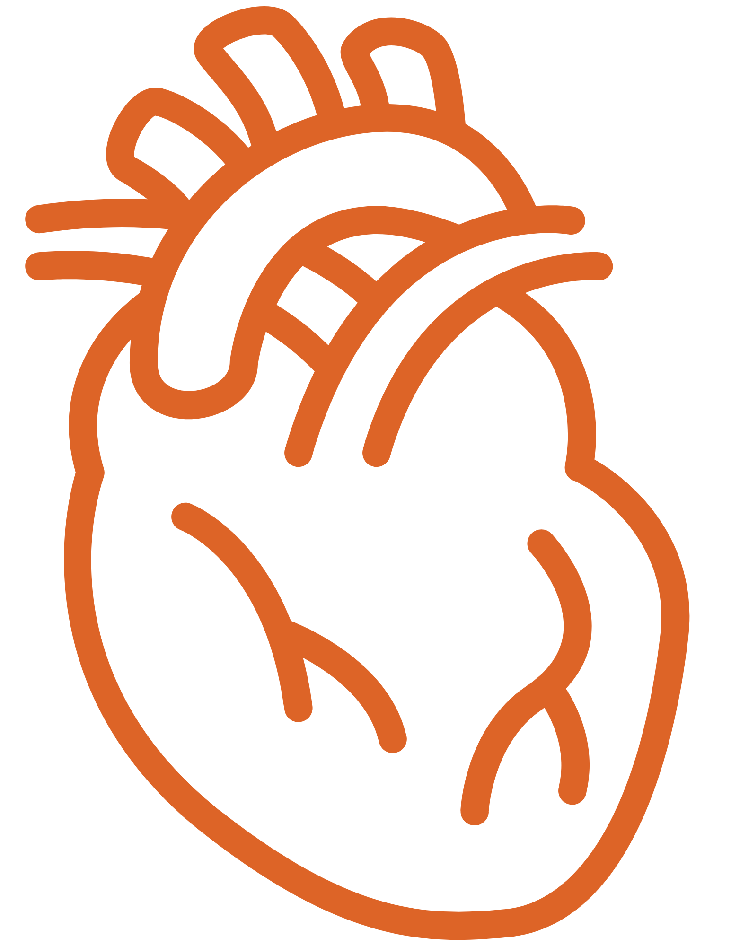
The Cardiovascular System
Key Point: The main components of the cardiovascular system are the heart, arteries and veins, kidneys, and blood
Key Point: The main functions of the cardiovascular system are:
- To supply tissues with oxygen and nutrients
- To remove excess waste material from each tissue
- To deliver waste to the appropriate organs for disposal
Tissues are groups of cells with a common function
Organs are comprised of tissues that together, perform some function
  Groups of organs working together make up an organ system
Notes:
ADD Banner:
The concept of receptors was unproven for 80 years until the cloning of the first receptor

Slide 4
The Cardiovascular System (Cont.)
Diseases of the cardiovascular system are the most common cause of death in developed economies
There are many genetic diseases of the cardiovascular system; some of them are nano-rare

Slide 5
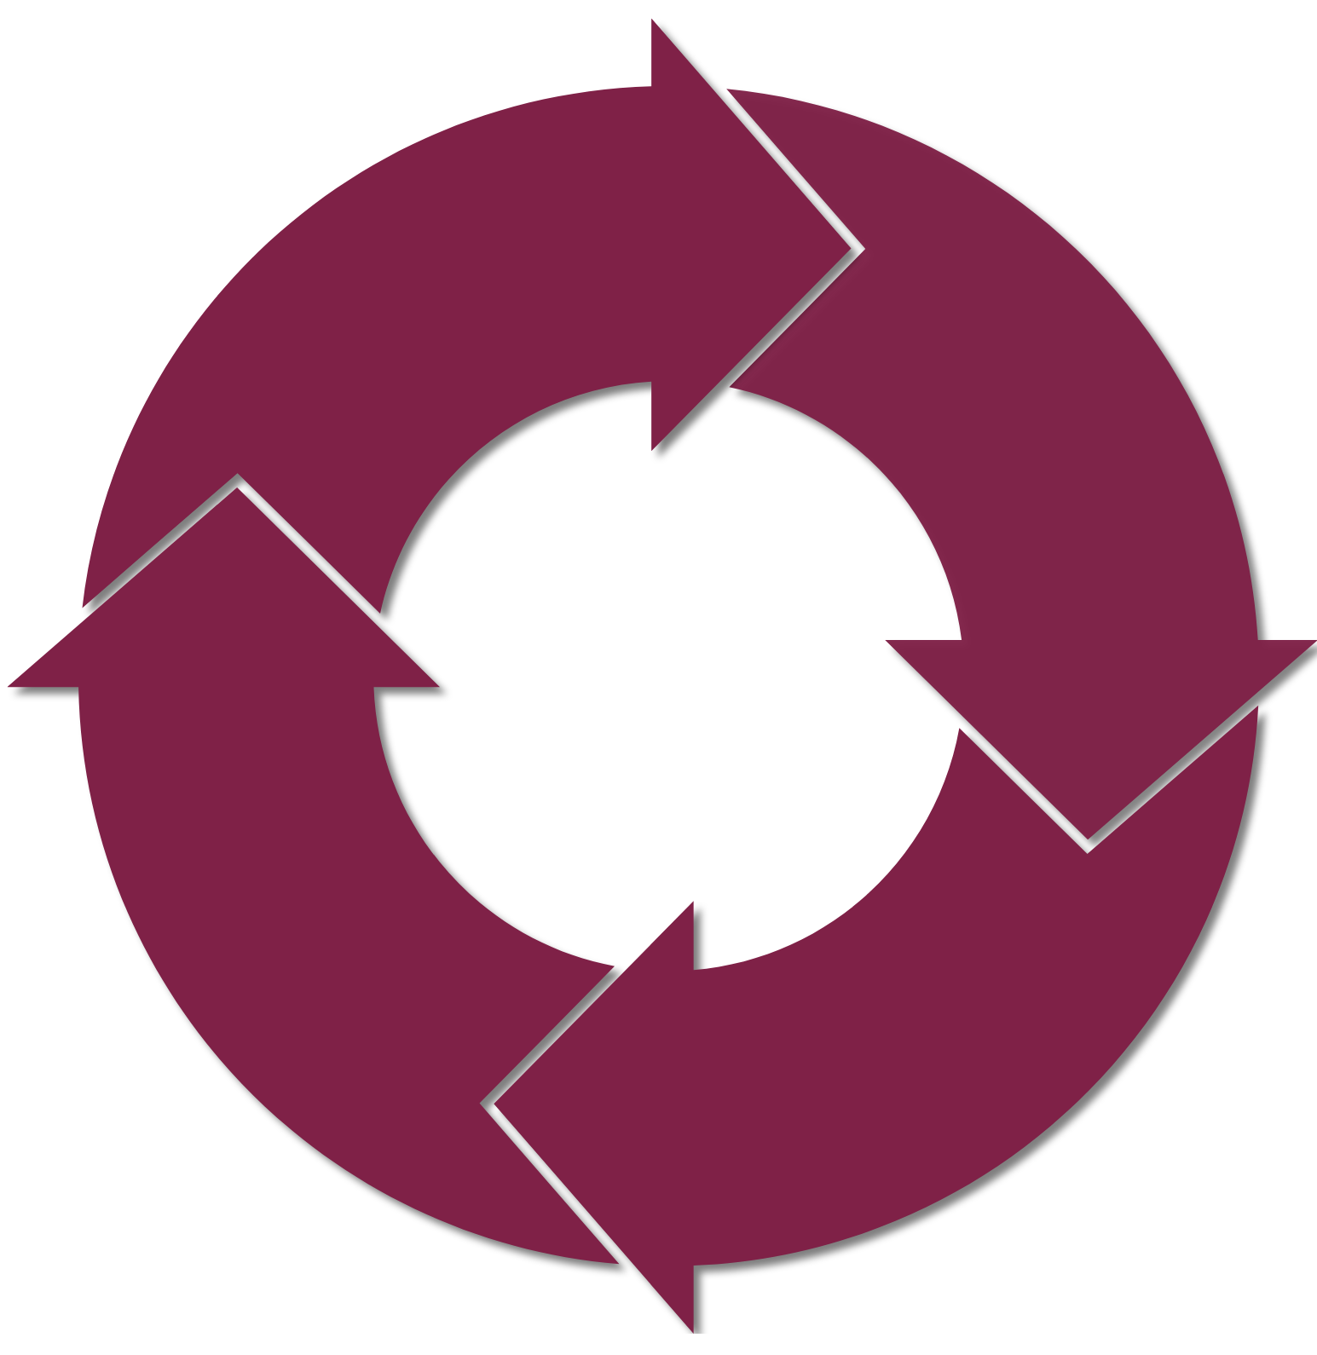
Blood and the Oxygen Cycle
The Oxygen Cycle is continuous
In the lungs, blood exchanges carbon dioxide for oxygen
Blood delivers the oxygen and nutrients to all the body’s tissues and organs
Blood then collects waste, including carbon dioxide, and delivers it to the proper organs for disposal
Finally, blood exchanges the carbon dioxide it has collected for oxygen in the lungs

Slide 6
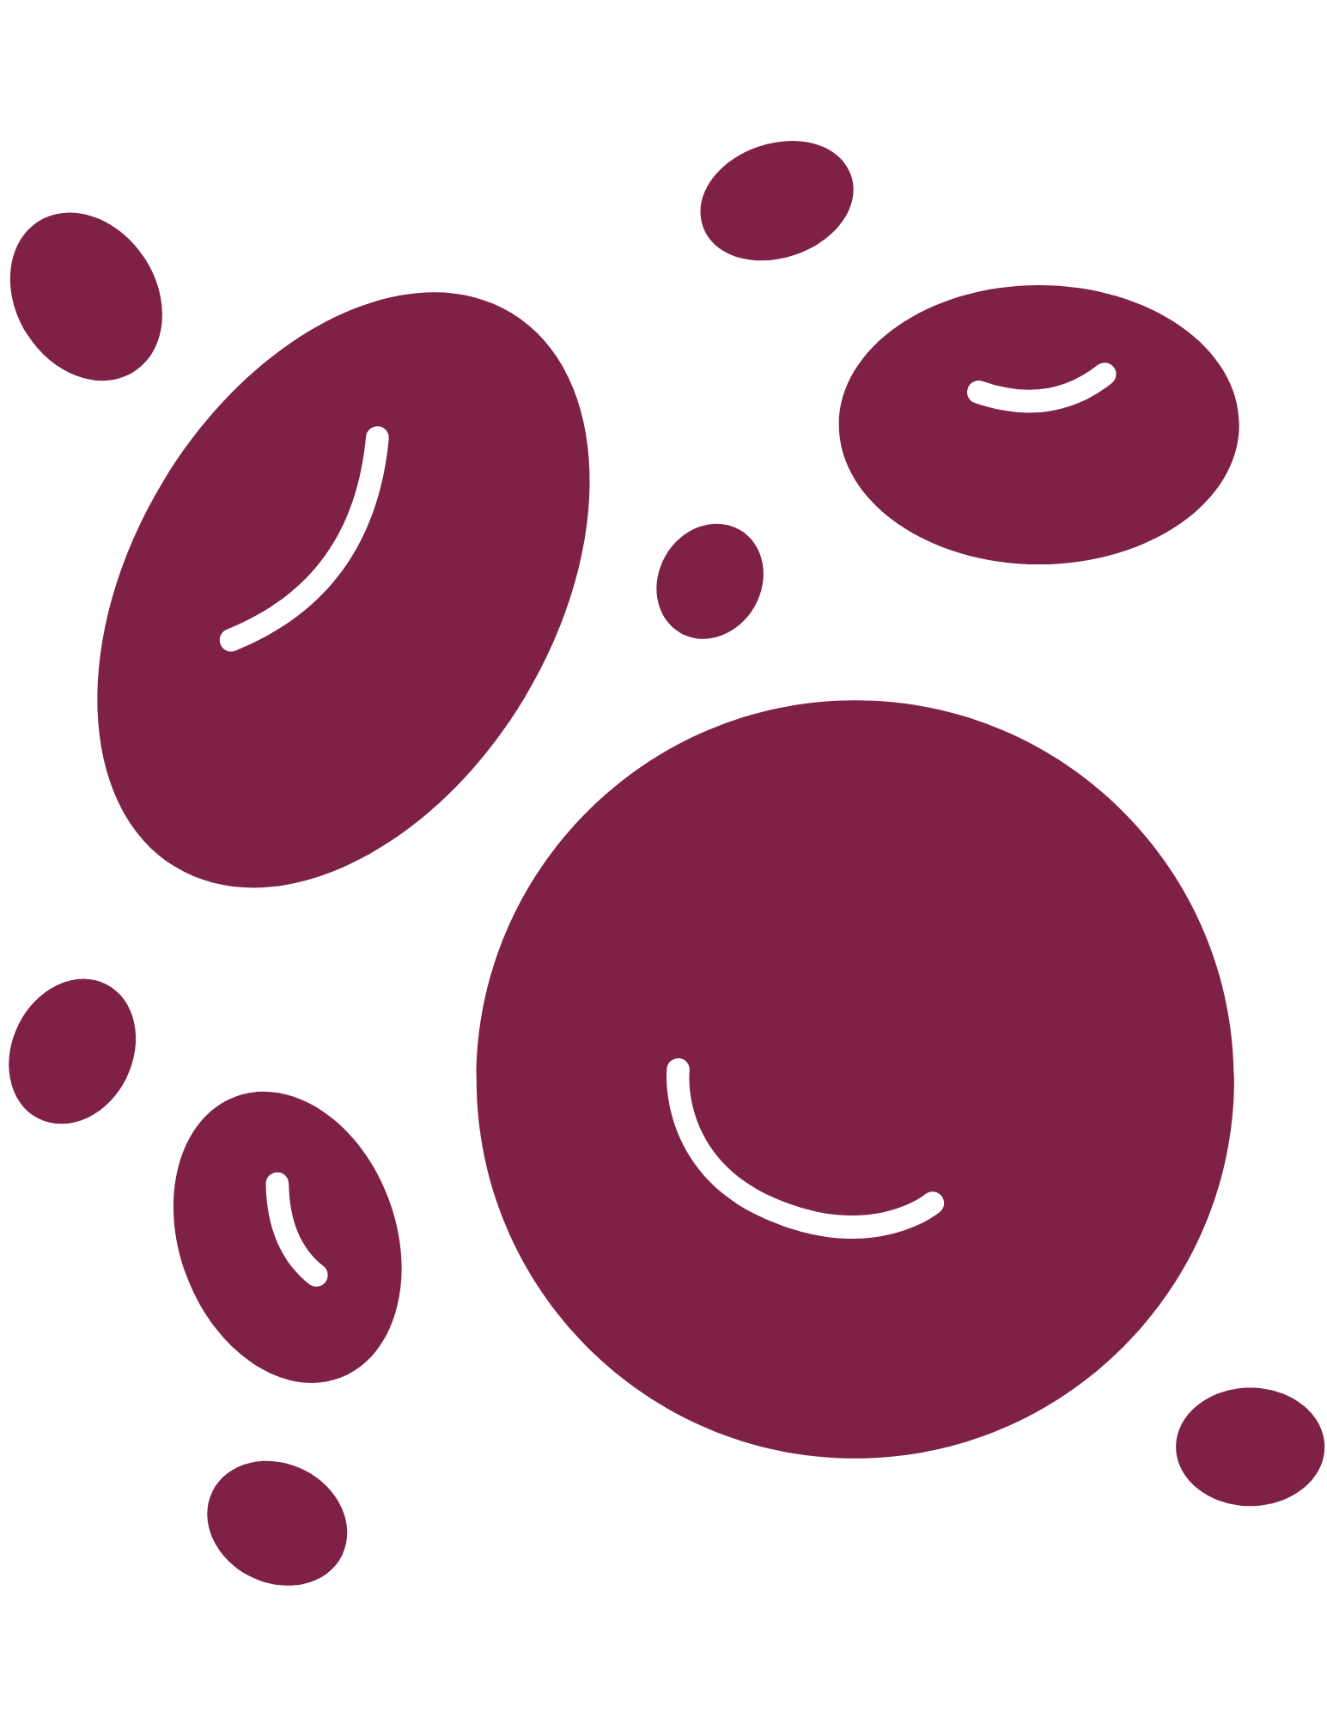
Supporting The Oxygen Cycle
Key Point: A specialized protein in the blood called hemoglobin supports the tightly controlled oxygen cycle
Hemoglobin: the protein contained in red blood cells that is responsible for delivery of oxygen to the tissues
Red blood cells do not have a nucleus and cannot divide - they just die
Bone marrow is constantly making new red blood cells
The oxidation of iron releases valuable energy
  The oxidation state of iron moves from +2 to +3
Key Point: If red blood cell levels are too low, the liver makes erythropoietin and dispatches it to the bone marrow that signals it to make more red blood cells

Slide 7
Blood Diseases
Key Point: Many diseases are caused by mutations in hemogloblin
Key Point: Both low and high iron levels cause disease
Anemia: Inadequate number of healthy red blood cells - low on iron
Sickle Cell Anemia: A mutation in hemoglobin that prevents malaria from reproducing
  When Sickle Cell Anemia is present, the hemoglobin is abnormal, which causes the red blood cells to become hard and sticky and look like a C-shaped farm tool called a “sickle”
Hemochromatosis: Iron in excess
Polycythemia: The production of too many red blood cells

Slide 8
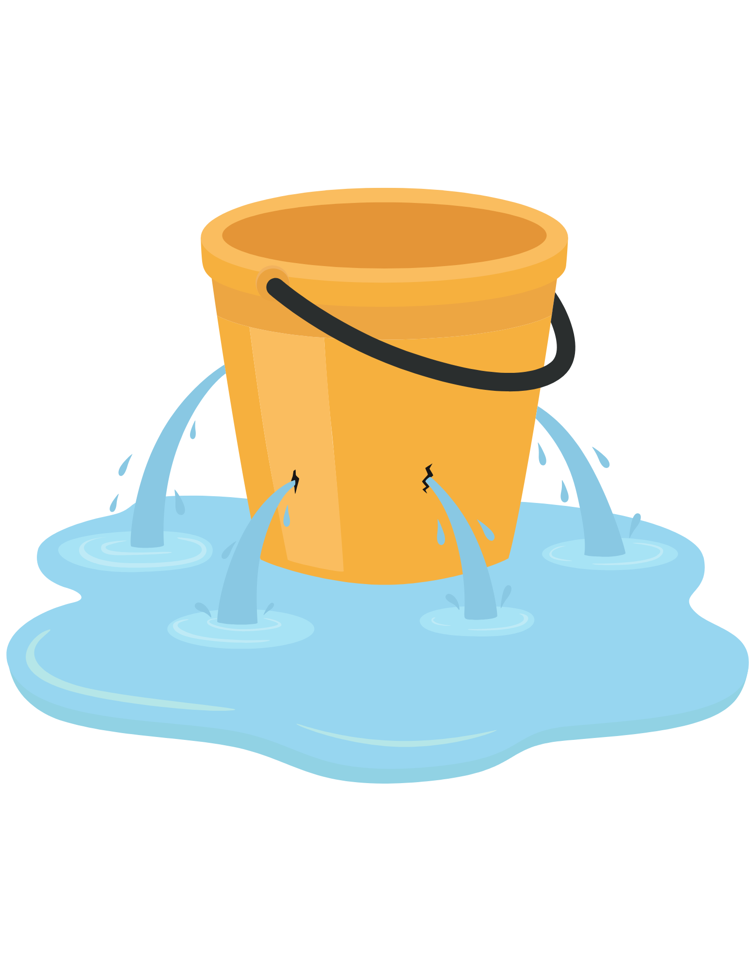
Leaks and Obstructions
Externally caused leaks of blood vessels are normally caused by trauma
  Stabs, cuts, etc.
Cancer is the most common external cause of a blood vessel leak
Arteries are high in pressure and carry blood from the heart to the organs
Veins are low in pressure and are more likely to have an obstruction than arteries

Slide 9
Leaks and Obstructions (cont.)
Aneurysm: A rip in an artery
  Serious and is a surgical emergency
Infarction: Cell death in a tissue due to lack of oxygen
Stroke: Infarction in the brain
Atherosclerosis: stiffening of arteries due to a buildup of fat or lipids on an arterial wall

Slide 10
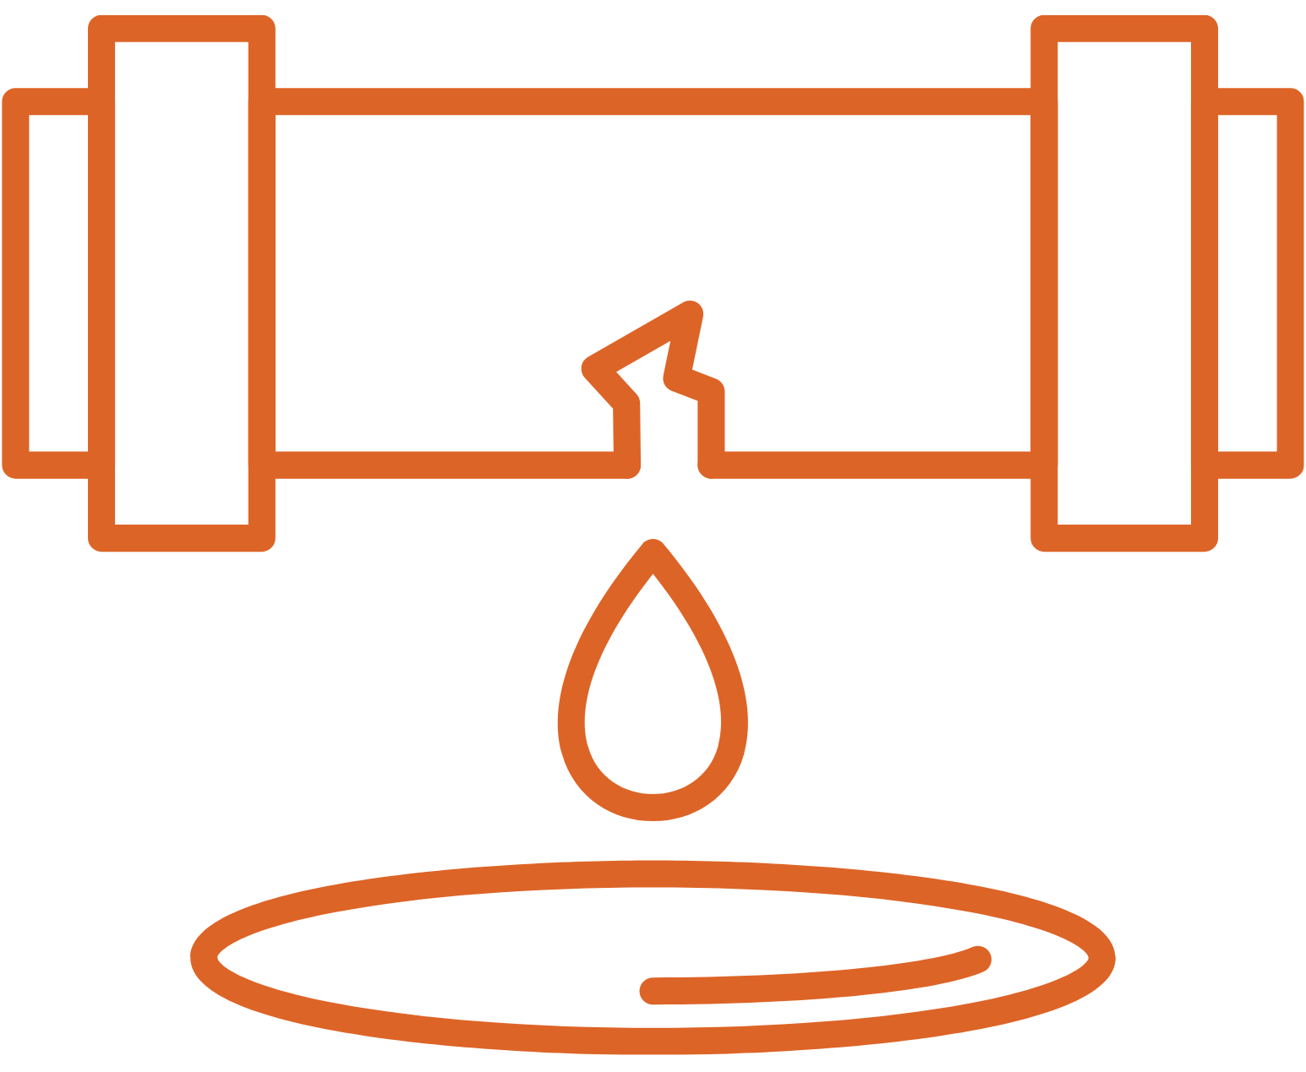
How to Stop Leaks
Key Point: Blood must flow easily, and it must be able to respond to leaks immediately
Key Point: A major component of the clotting system is a set of cells called platelets
When blood vessels leak, a chemical signal is released that orders the platelets to begin to plug the leak
  Platelets are a kind of cell that sit on the leak and signal the clotting factors to build a permanent patch or scab
  Platelets level and activity are tightly controlled
  If platelet levels are too low, a factor made in the liver, thrombopoietin, is dispatched to the bone marrow to stimulate the production of more platelets

Slide 11
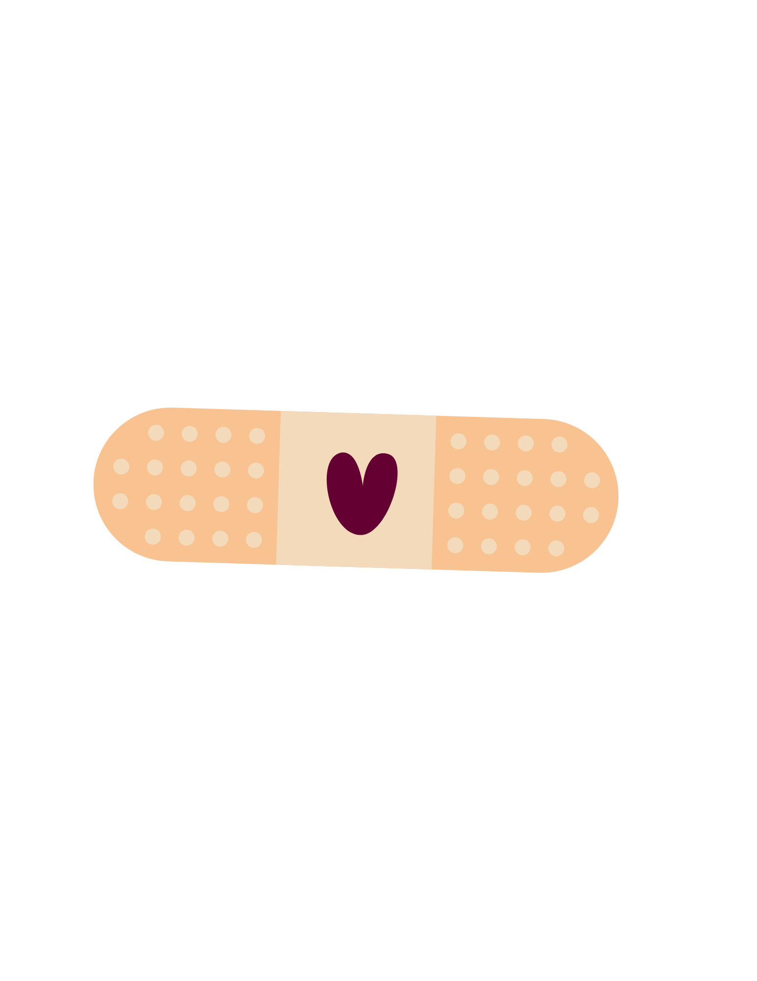
Clotting
Key Point: Clotting is managed by clotting factors, made in the liver; they are proteases made to be inactive but easily activated
Clotting factors are proteins which are made in the liver
  Clotting factors are enzymes which are made in an inactive form called proteases, which is easily converted into an active form by the removal of a protein from the enzymatic center
  There are 12 clotting factors that act in a multi-step cascade

Slide 12
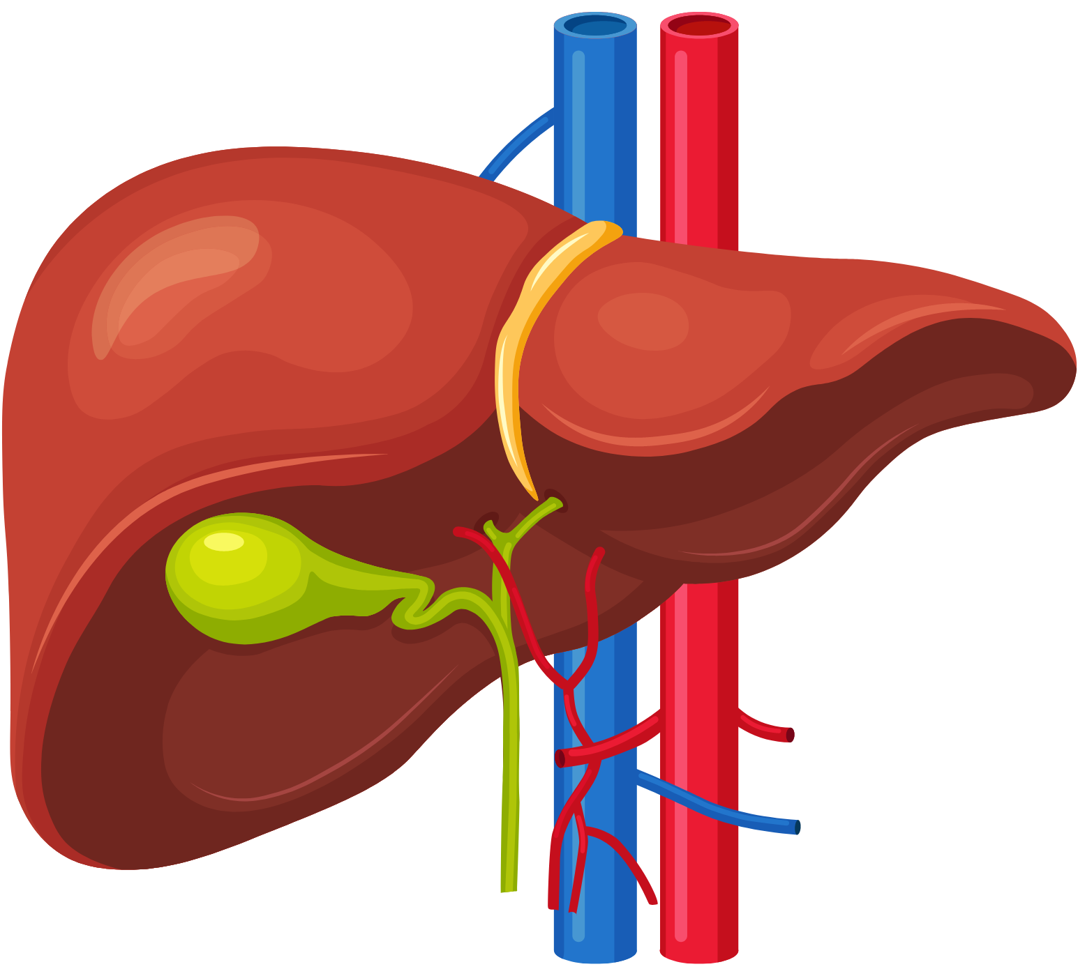
The Liver’s Role in Blood
The liver has two main jobs:
  The production of necessary proteins for the performance of blood and other organs
  To filter blood from veins and extract waste
Thrombocytopenia: A condition where a patient makes antibodies that recognize platelets as foreign invaders, resulting in low platelet count
The destruction of liver cells, which can happen from starvation or excess consumption of alcohol, can impede the production of clotting factors
Hemophilias: When blood do not clot properly
  Hemophilias are often caused by mutations that prevent the production of clotting factors

Slide 13
Loss of Blood
Key Point: If clotting is not properly regulated, serious, often fatal diseases are caused
A sudden loss of blood generates an emergency response in the body leading to a rapid reduction of blood pressure
  The amount of blood returning to the heart from the veins is reduced
  The right atrium does not fill properly; the right ventricle is unable to pump the right amount of blood to the lungs
  Less blood gets oxygenated
  The left atrium and left ventricle are also impaired; the reduced output of blood from the left ventricle is called reduced cardiac output
  Reduced cardiac output is sensed by the autonomic nervous system and noradrenaline is released; increasing heart rate and causes a contraction of the major arteries
  If left untreated, a fatal arrhythmia in the heart will occur

Slide 14





Follow us on:
Instagram:
nloremfoundation
Facebook:
@nloremfoundation
LinkedIn:
n-Lorem Foundation
Twitter:
@n_lorem

Slide 15

Thank you for listening!
Find more podcasts and videos at:
www.nlorem.org

