Slide 1
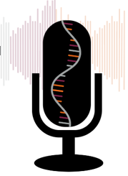
Intro to Medical Science:
Biological Systems and Chemical Networks
Slides to accompany Podcast Episode #3. For more Intro to Medical Science visit www.nlorem.org

Slide 2
Find our Podcast Series on any of your podcast streaming apps or on our website, www.nlorem.org Questions/inquiries can be sent to podcast@nlorem.org

Slide 3
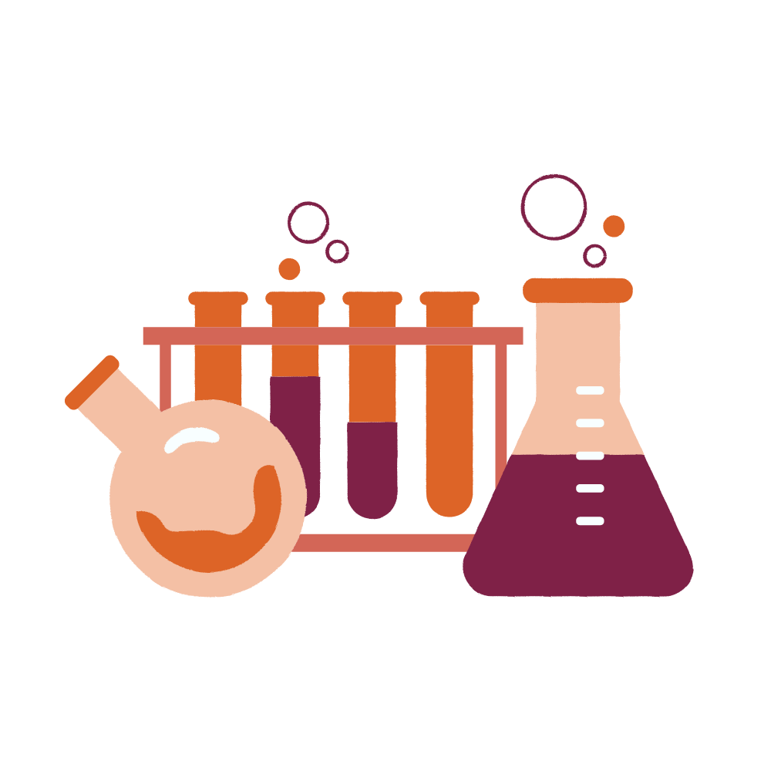
All Drugs Are Chemicals
Drugs are administered to humans or animals to alter characteristics
Phenotypes are the observable characteristics in an organism, or symptoms
A genotype is the complete set of an individual’s genetic material
Key Point: Drugs are administered to alter the phenotype of patients into healthier phenotypes and most drugs are designed not to affect the genotype. Gene therapy and CRISPR can create healthier phenotypes by altering the genotype

Slide 4
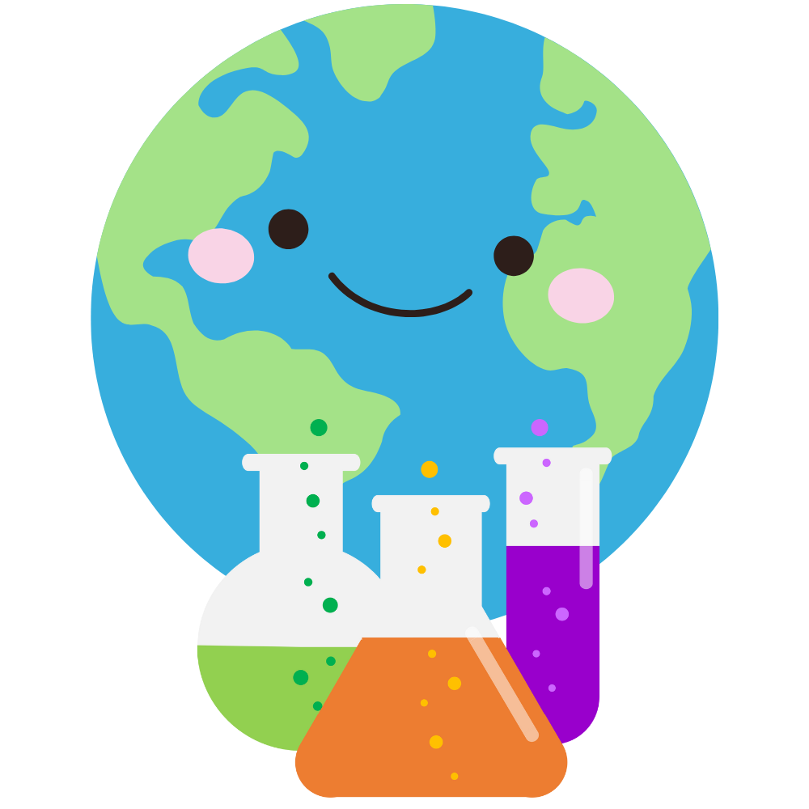
Our World is Made Up of Chemicals
All drugs are chemicals
All chemicals project a unique signature or pattern in 3D space defined by:
Size
Shape
Distribution of positive and negative charges
Distribution of hydro (water) phyllic (water-liking) and
hydrophobic (water-hating) or lipophilic (fat-liking)
The size of a chemical is measured in units called Daltons (D)
The size of chemicals vary:
1D (hydrogen) to up to many millions of Daltons

Slide 5
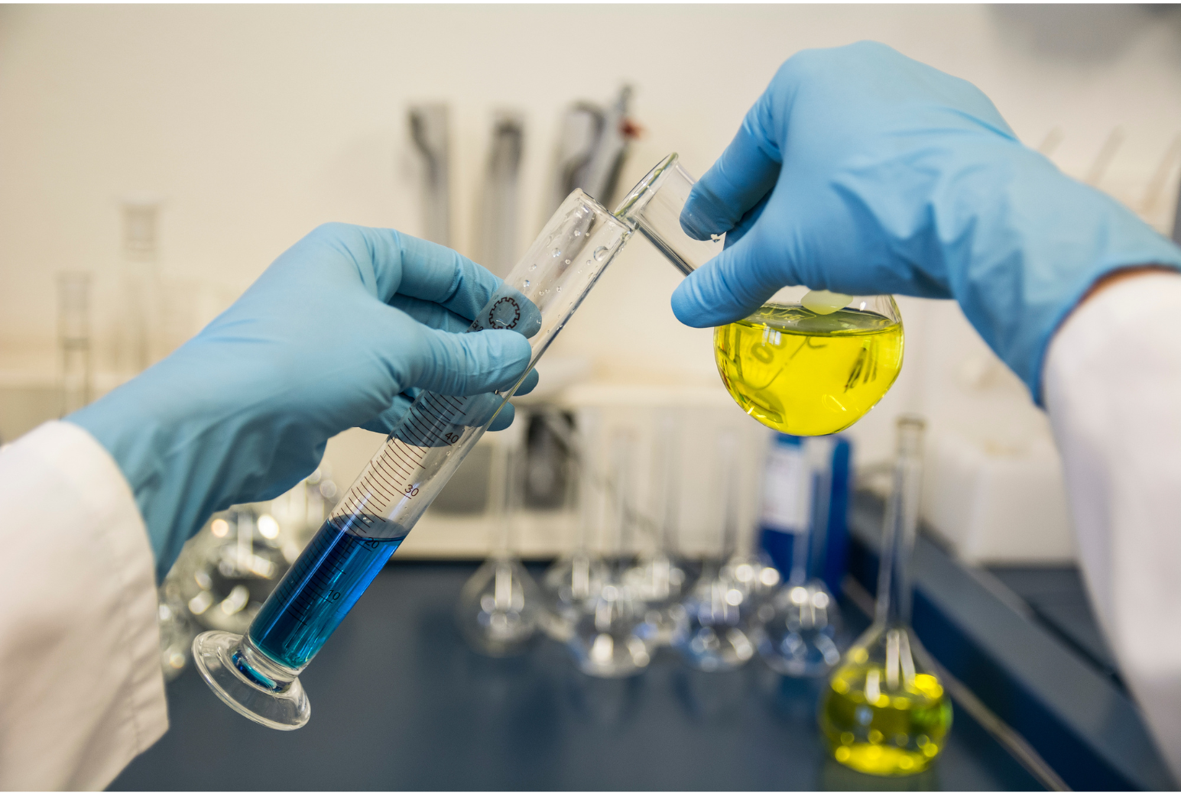
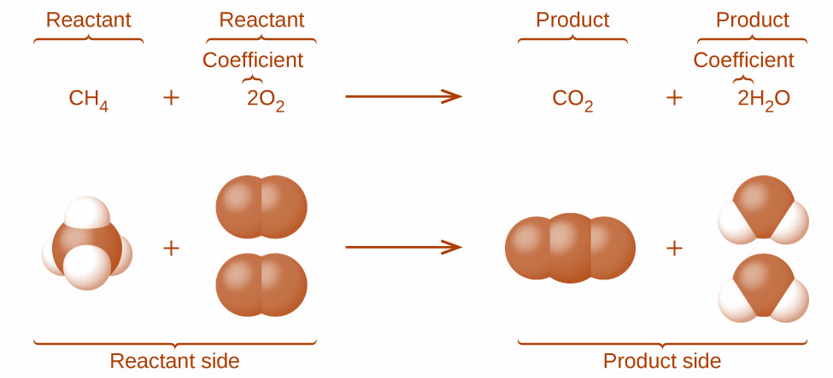
Chemical Reactions
Key Point: Each chemical has a unique three-dimensional pattern. Chemical reactions begin with the collision of two or more chemicals. Thus, all chemical reactions are concentration dependent.
The frequency of collisions is a function of the number of molecules per unit volume
The reacting chemicals change, forming the products

Slide 6
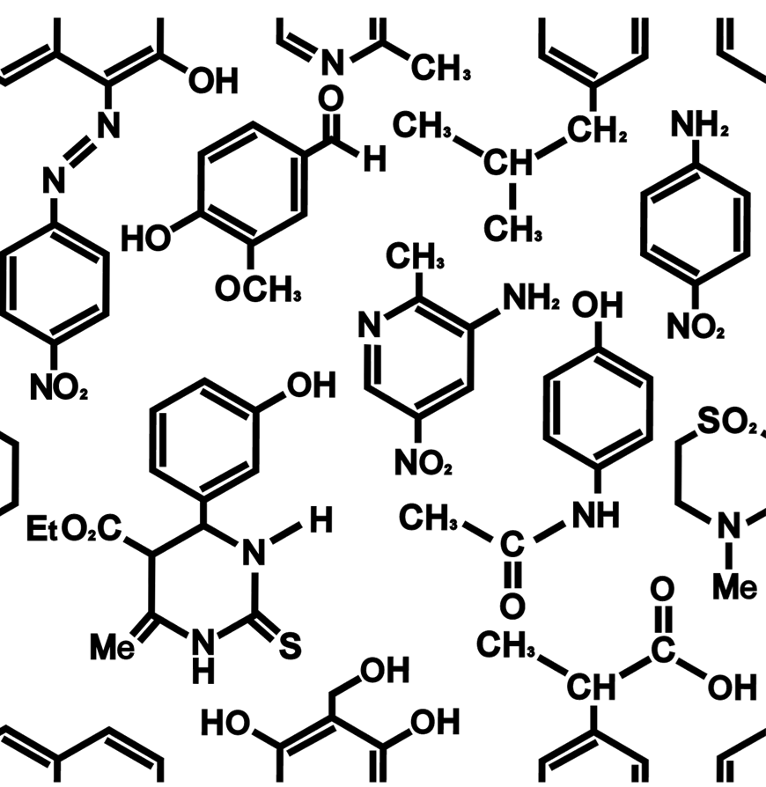
Biochemicals
Drugs are chemicals, so the effects of drugs are concentration dependent
We adjust the concentration of a drug by adjusting the dose
Biochemicals are chemicals within organisms that are essential to life and create biological systems
A biological system is a set of networks of chemicals and chemical reactions that result in a biological behavior
Key Point: We are incredibly complex networks of biochemicals and biochemical reactions that create the phenotype we recognize when we look at ourselves in the mirror

Slide 7
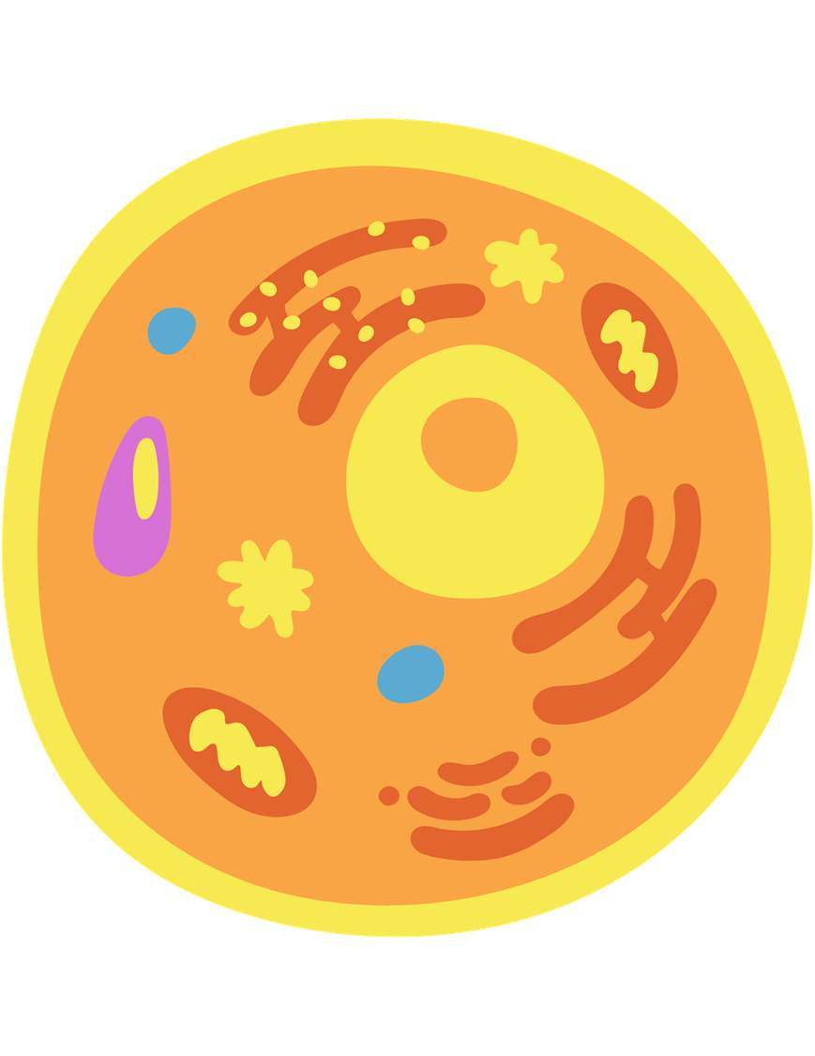
Cells
Cells are the smallest unit of life, but why do we have them?
Key Point: Cells are designed to concentrate the chemicals of life so that biochemical reactions can be produced and result in life
The plasma membrane protects the cell from its environment
It’s composed of fats, lipids, and lipids with a negatively charged phosphate group called phospholipids
Various proteins enter and exit the plasma membrane
Functions of the cell: Integrate all the chemicals and chemical reactions into complex networks that create the phenotype of that cell, respond to the environment by adjusting its phenotype, integrate with other cells to create organs
These organs are integrated into a more complex set of networks, and composite set of behaviors are created

Slide 8
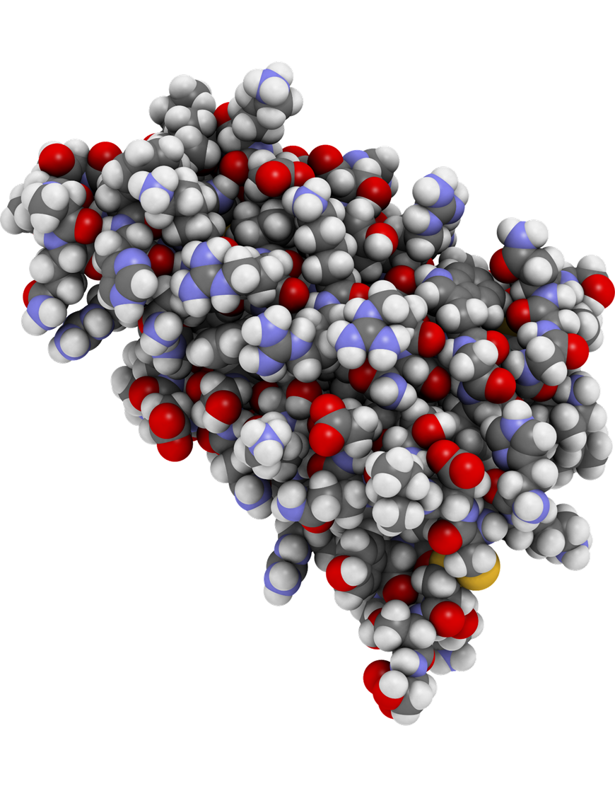
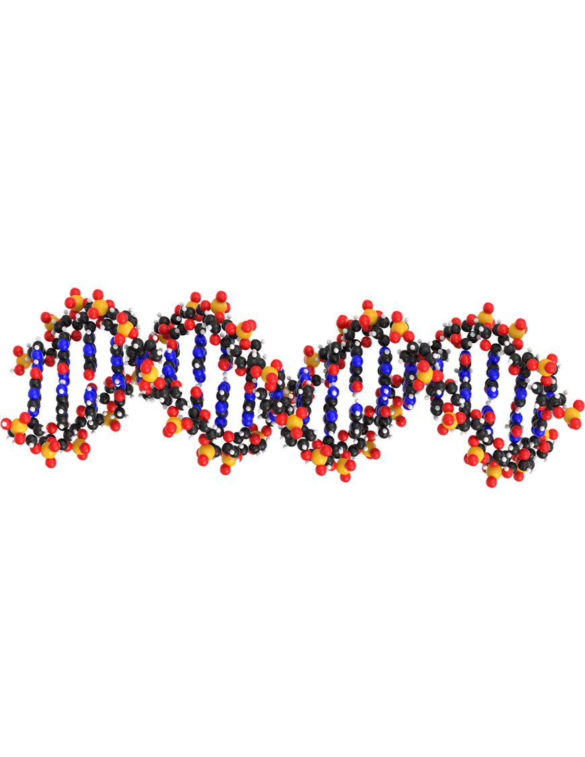
Polymers
Polymers are chemicals
that are comprised of many units
Proteins are important polymers
The units they are composed of (monomers) are called amino acids
Amino acids are around 100 Daltons
Proteins can be millions of Daltons in size
Nucleic acids are another important monomer
Nucleic acids are composed of nucleotides
Nucleotides are around 300 D

Slide 9
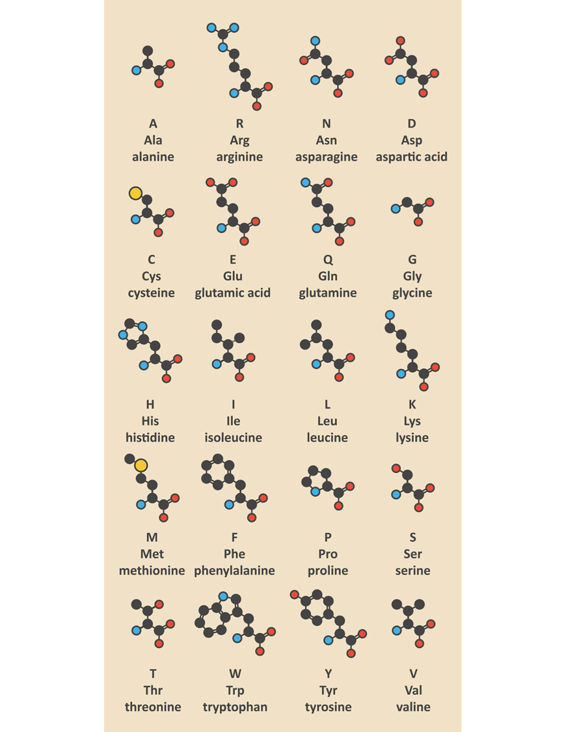
The Languages of Life
Two nucleic acids are important: DNA and RNA
DNA is made up of millions of nucleotides
RNA is usually thousands of nucleotides
Each cell has a set of “employees” that do the work
These are the proteins
Twenty basic amino acids make up the protein language
You can think of the protein lange as being almost as complex as English
The nucleic acid language is simpler
Composed of four letters: ATCG
In RNA, the four letters are AUCG
This is about as simple as Morse code

Slide 10
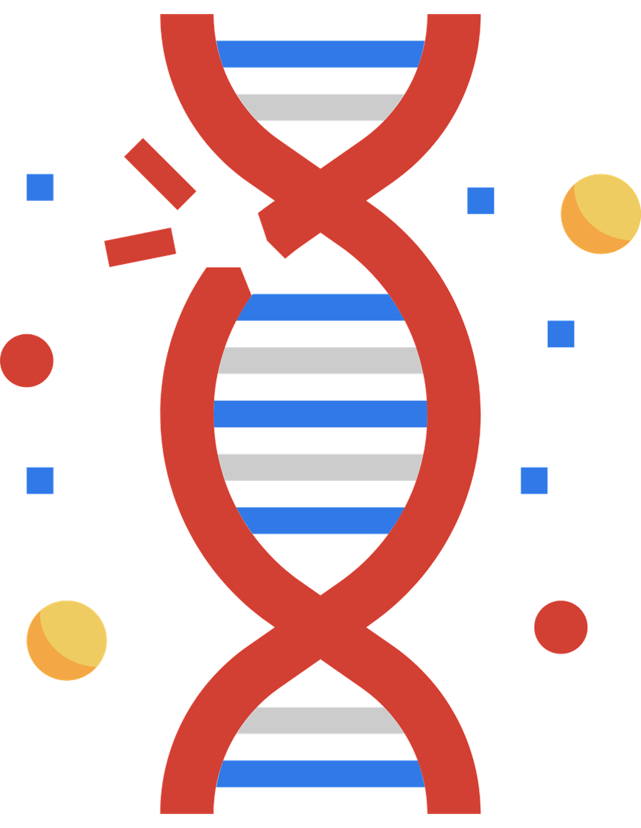
DNA
Information from the DNA must be stored and protected
In the cell, DNA is compressed into structures called chromatin
Humans have 23 chromosomes
DNA has two strands
DNA read left to right is called sense
The strand that is a mirror image is called antisense
Some chemicals can damage our DNA
A change in our DNA that is not corrected by one of our defense systems is called a mutation
Not all mutations are bad
Mutations are the source of the diversity of biological life

Slide 11
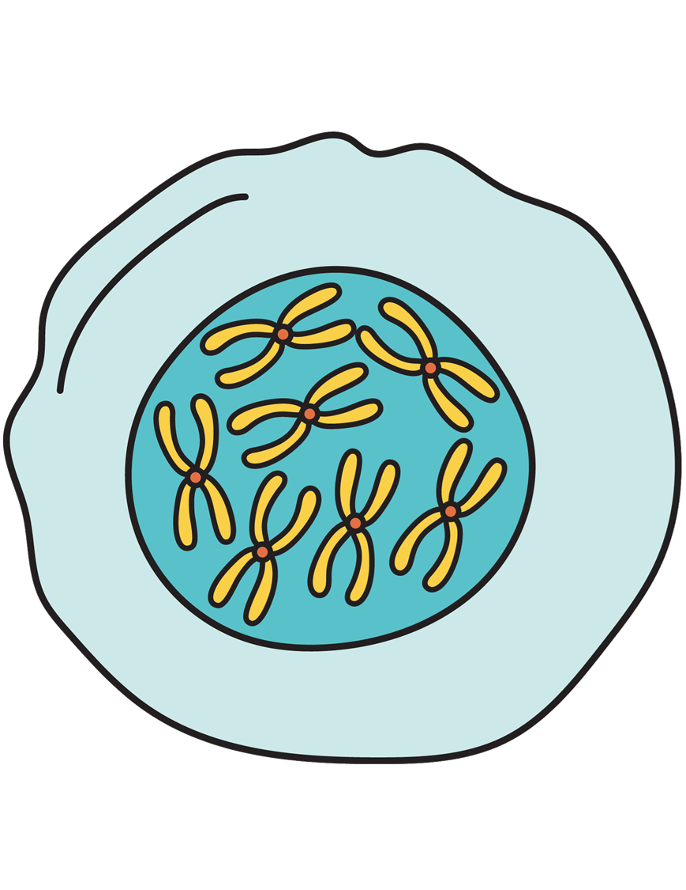
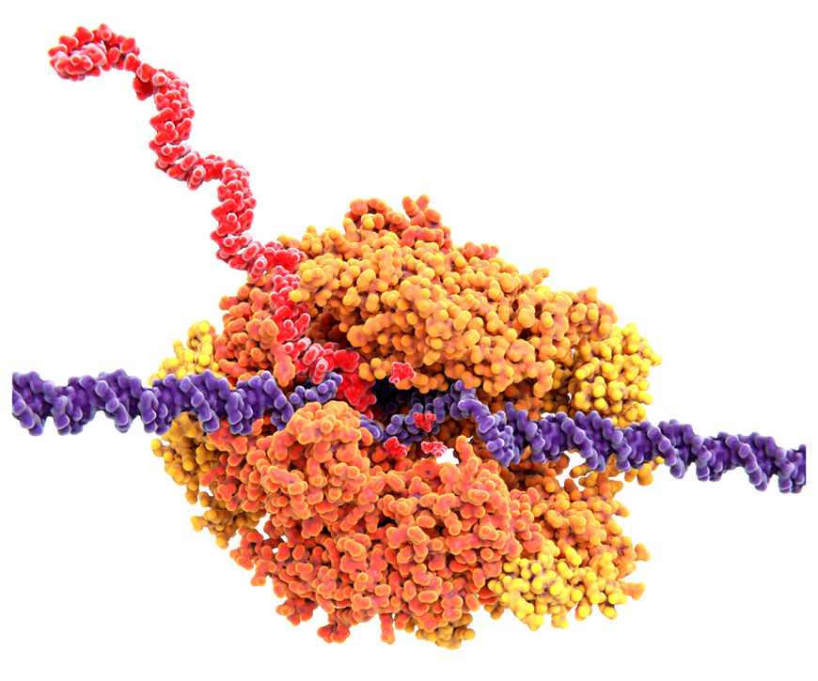
RNA
Key Point: Polymers are incredibly important for biological systems. Each cell stores genotype information carefully. When it needs to use some of that information, an RNA molecule is made. When RNA is made, it is called transcription. If RNA is used to make a protein, the information has to be converted to the amino acid language and that process is called translation.
RNA designed to make a protein is called messenger RNA (mRNA)

Slide 12
The Takeaway: Drugs
Drugs are used to alter a biological system
Change diseased symptoms, or phenotypes, into what we believe are healthier symptoms
A perfectly specific drug is one that we use for one specific effect, and does nothing else
A perfect drug does not exist
Even if there were a perfect drug, it would alter the composite of the networks in ways that are, at present, unpredictable
Networks that create a specific phenotype are unique for each patient
The effects of drugs vary between diseased and healthy patients
The effects of a drug vary drastically as a response to an incredibly complex and unique biological system

Slide 13
Follow us on:
Instagram:
nloremfoundation
Facebook:
@nloremfoundation
LinkedIn:
n-Lorem Foundation
Twitter:
@n_lorem

Slide 14
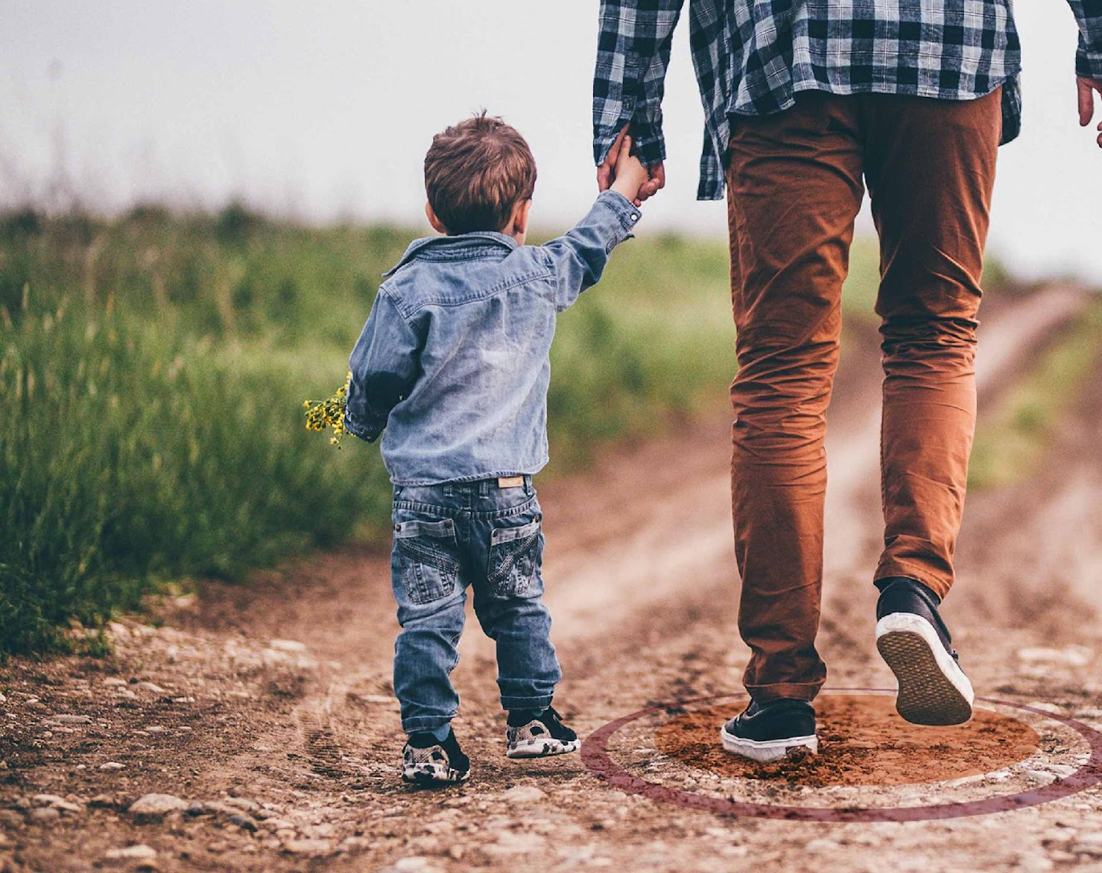
Thank you for watching!
Find more podcasts and videos at:
www.nlorem.org

